Slide 1
Object Detection

Slide 2
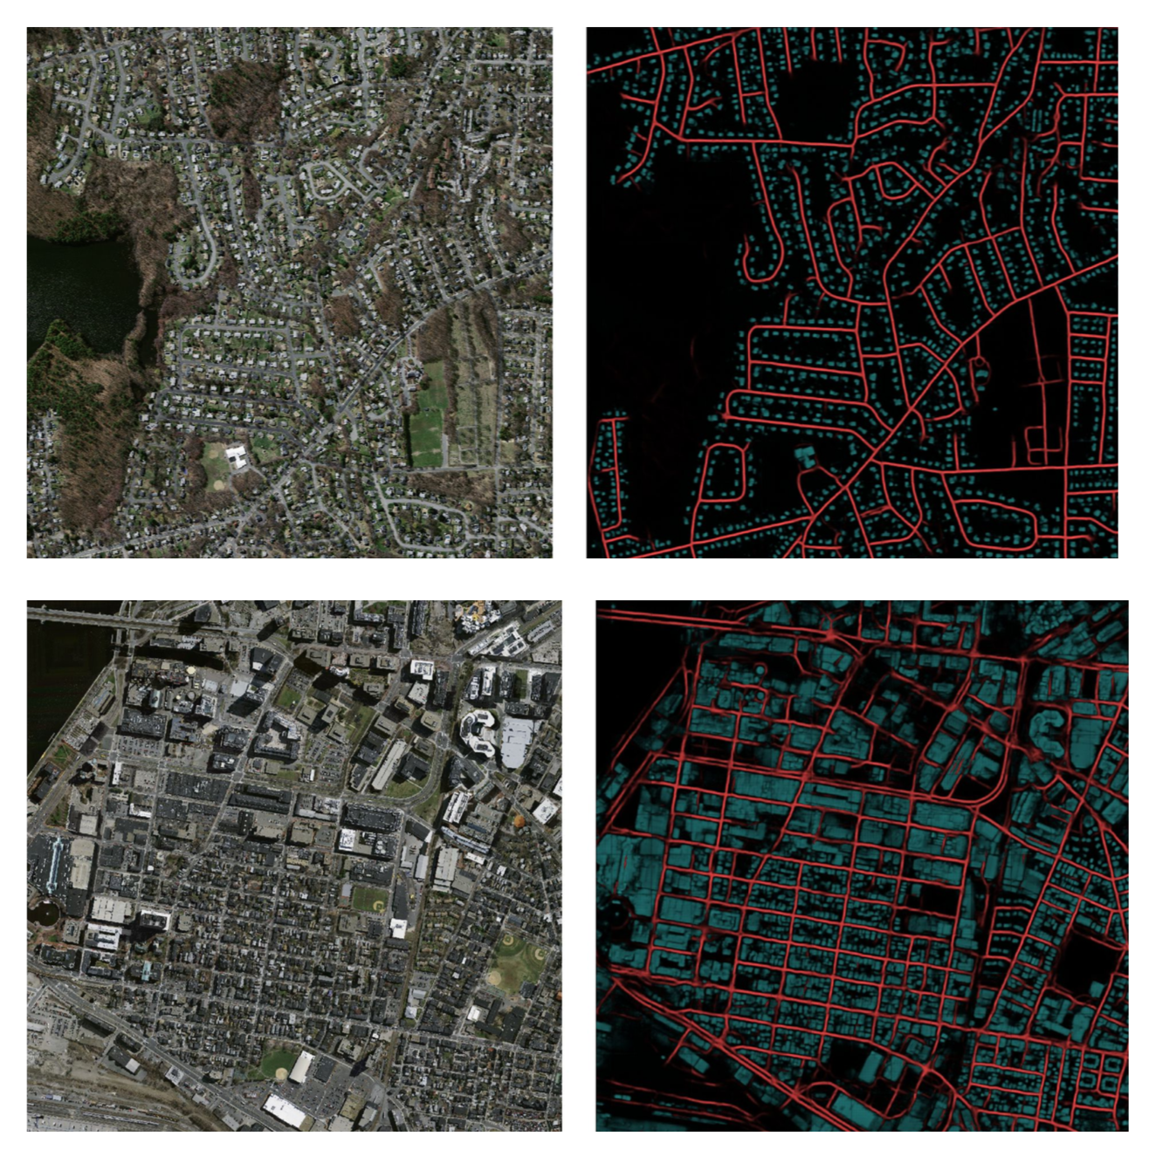
Semantic Segmentation
In this seminar, we have mostly dealt with semantic segmentation (pixel-wise classification).
How to count the number of objects of interest (houses, roads, etc) in the figures on the right?

Slide 3
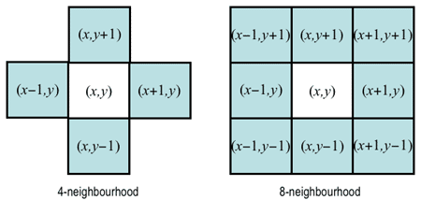
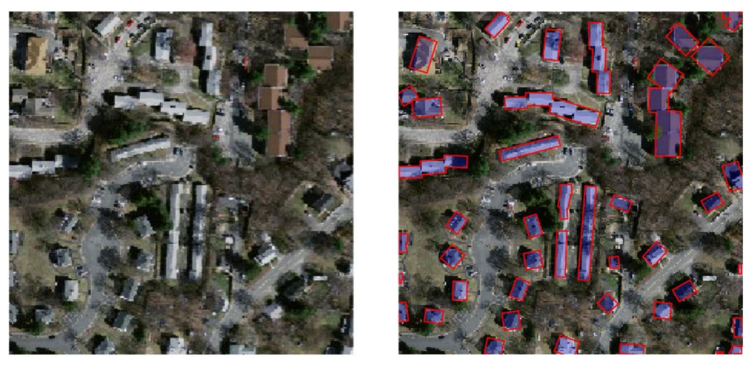
Semantic Segmentation to Object Detection
We can use connected components to cluster pixels associated to an object of interest.
What are some problems with this approach?

Slide 4
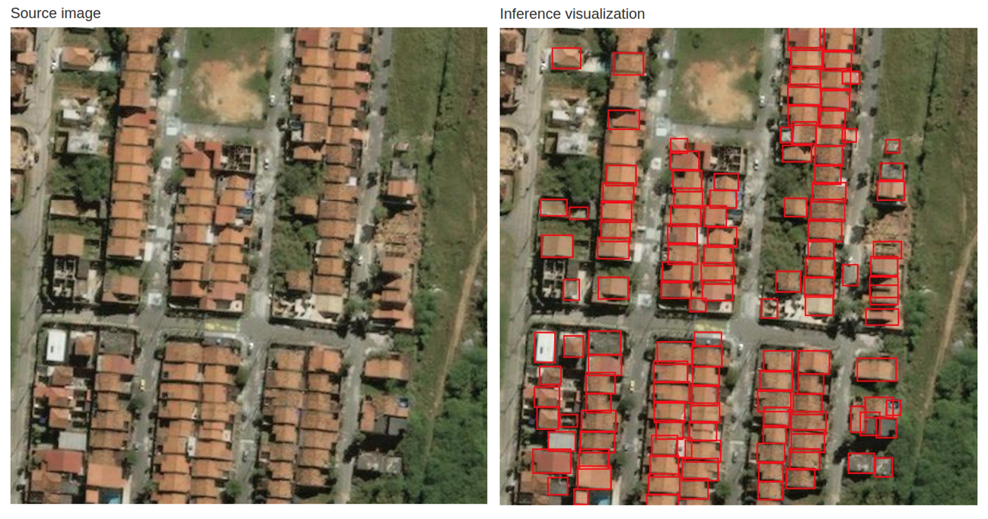
Object Detection
It is much easier to count objects in the following image.

Slide 5
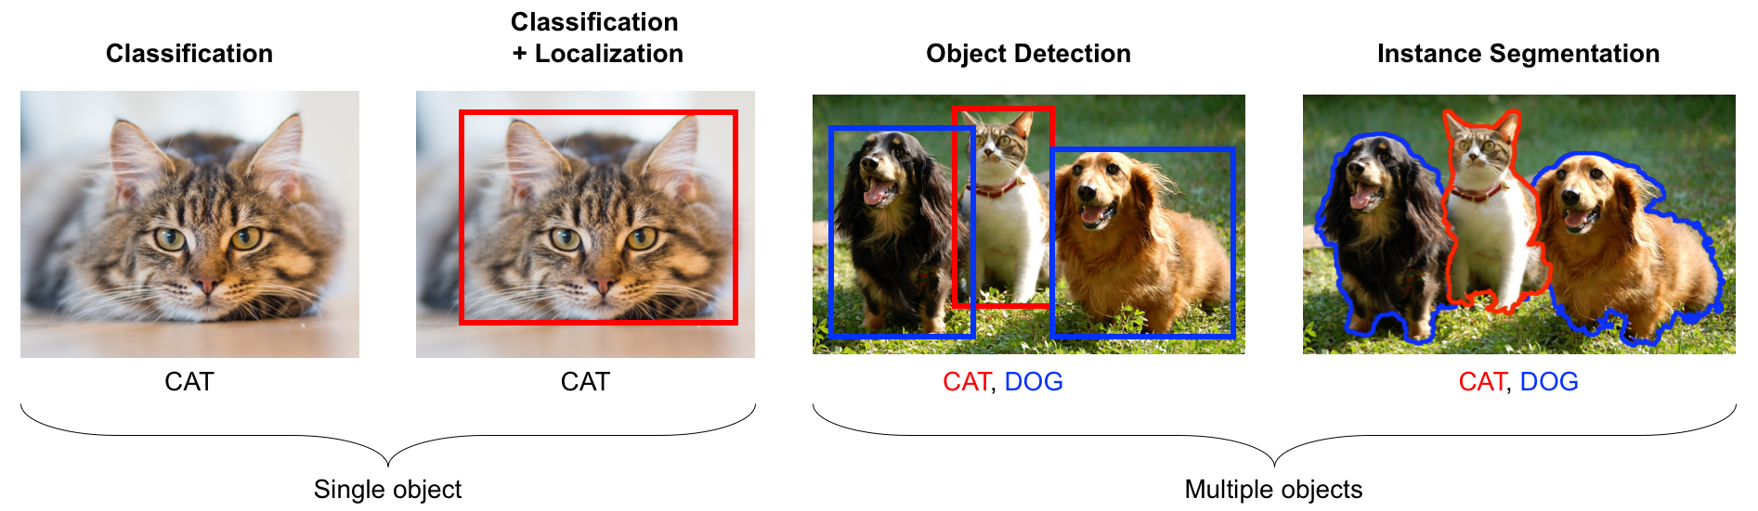
Classification vs. Localization vs. Segmentation

Slide 6
Object Detection: Naive Approach
We can use a sliding window to create candidate regions and pass them through a CNN to classify any object found within it.
Con: It's computationally expensive since most regions won't contain objects of interest.
Con: Need to consider several window sizes and aspect ratios to detect objects of different sizes.

Slide 7
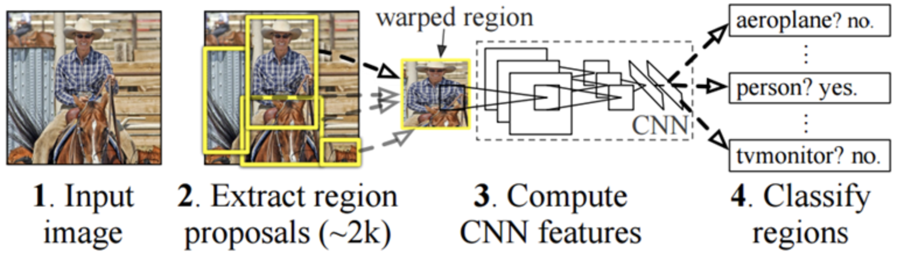
Region CNN (RCNN 2014)
Algorithm:
Come up with an intelligent way of creating regions of interest of different sizes and with different aspect ratios (selective search).
Warp each region of interest (ROI) into a fixed-size region to serve as input to the CNN.
Classify (SVMs) objects of interest and tighten bounding box (non-max suppression and regression) per ROI.

Slide 8
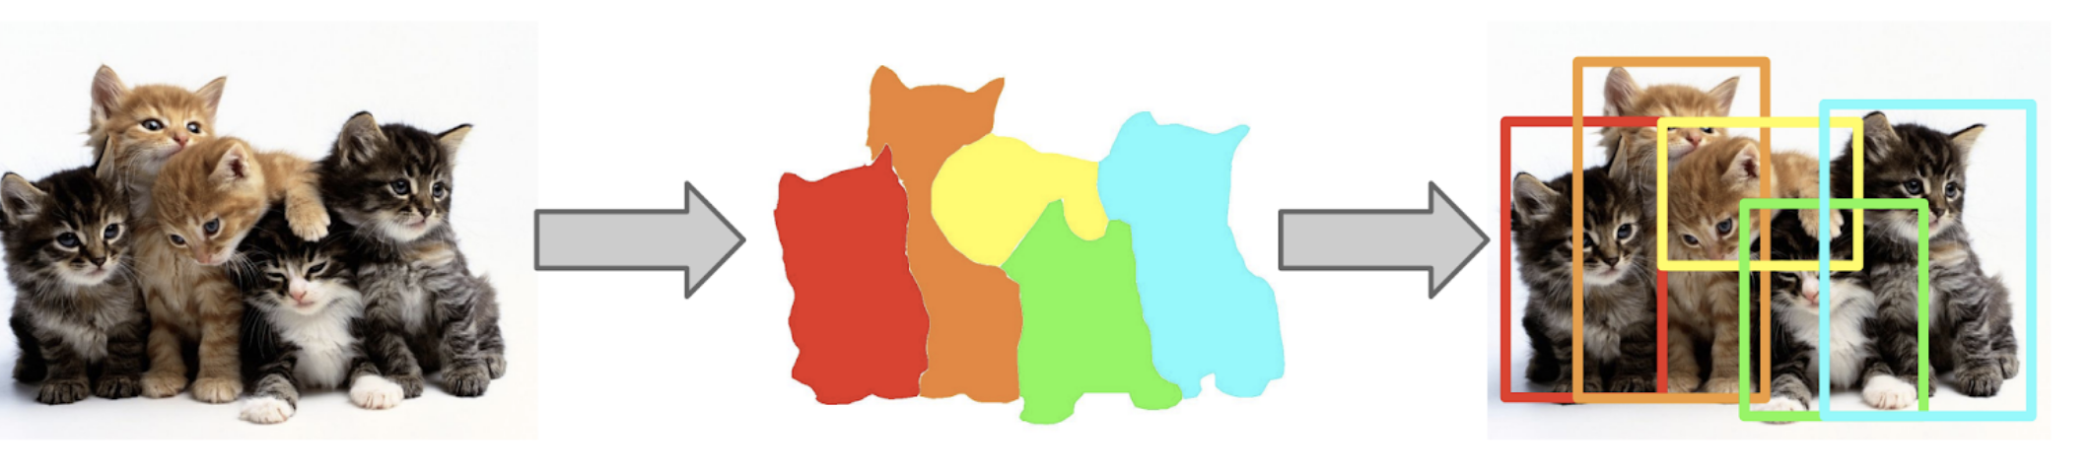
How to Improve Region Selection?
Idea: We can use the output of a basic segmentation algorithm (selective search) to suggest regions of interest.
Again, why don’t we run semantic segmentation and then use output to create bounding boxes?

Slide 9
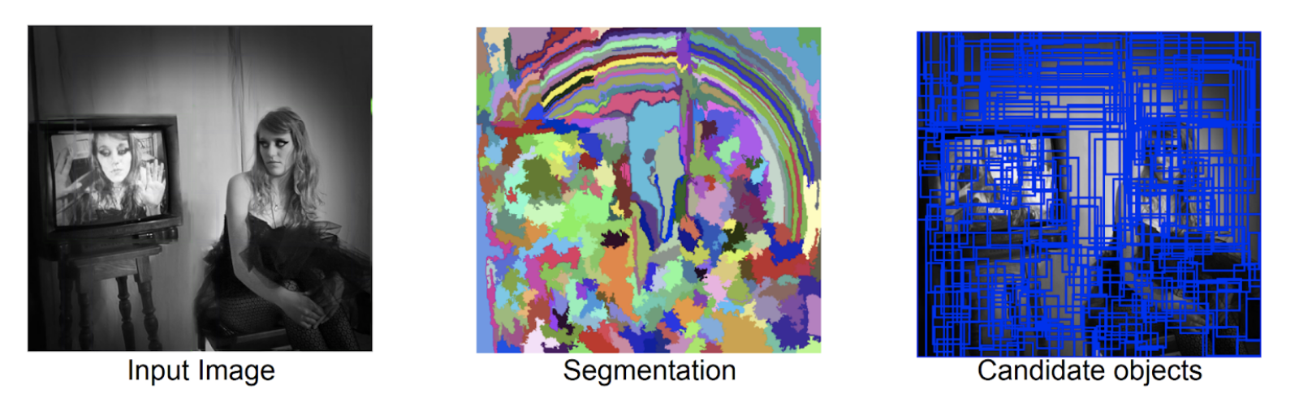
Selective Search (2012)
Step 1: Generate initial segmentation. This can be done by first detecting edges and then labeling segments separated by edges as different components.

Slide 10
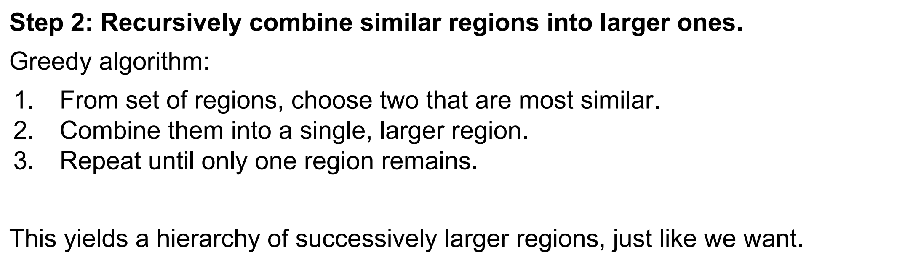
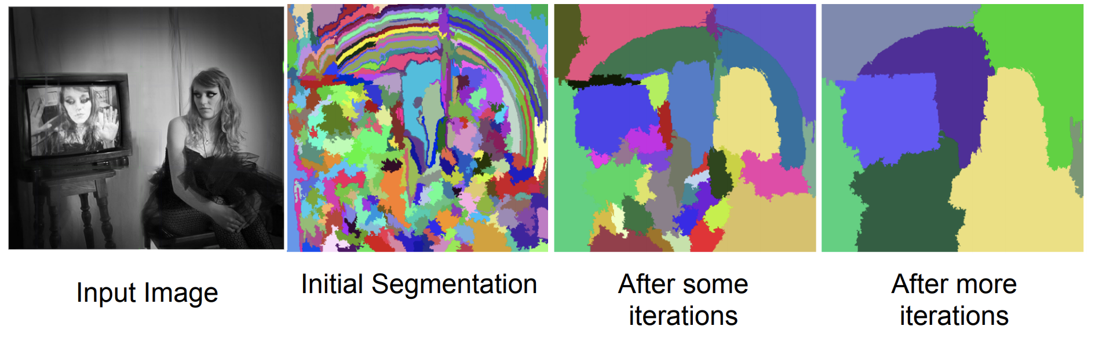
Selective Search (2012)

Slide 11
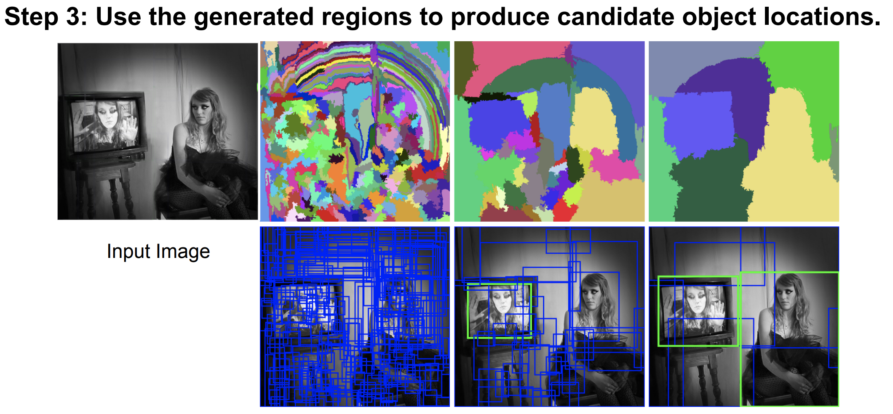
Selective Search (2012)
This algorithm produces regions of interest of different sizes and aspect ratios.

Slide 12
Selective Search: Similarity
The similarity function for selective search is a weighted sum of the following traditional computer vision features:
Color similarity.
Texture similarity.
Size similarity.
Shape similarity.

Slide 13
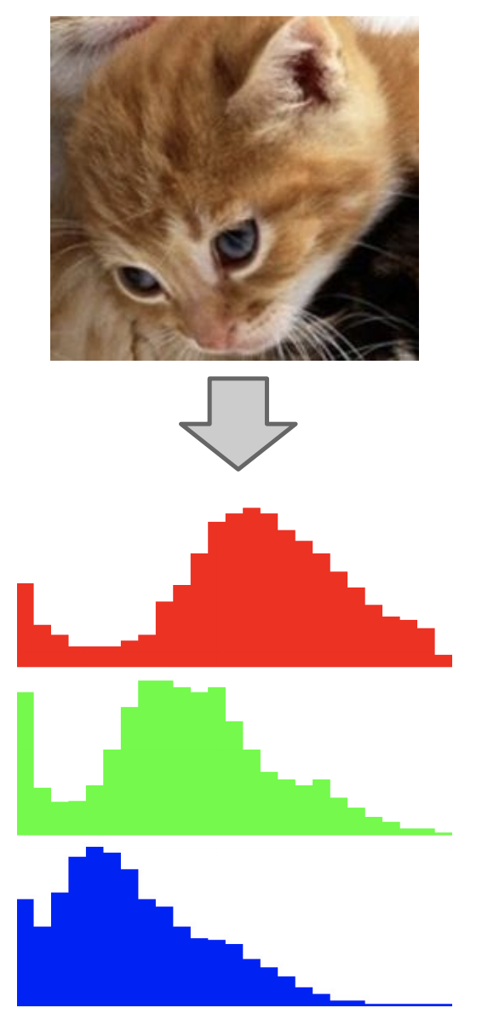
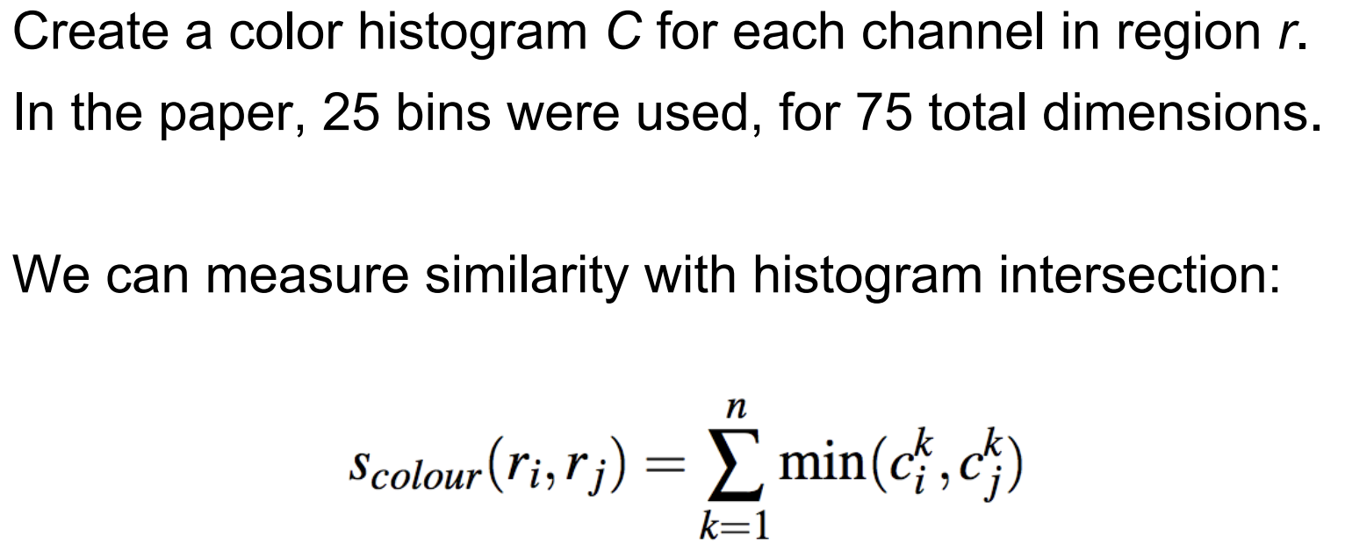
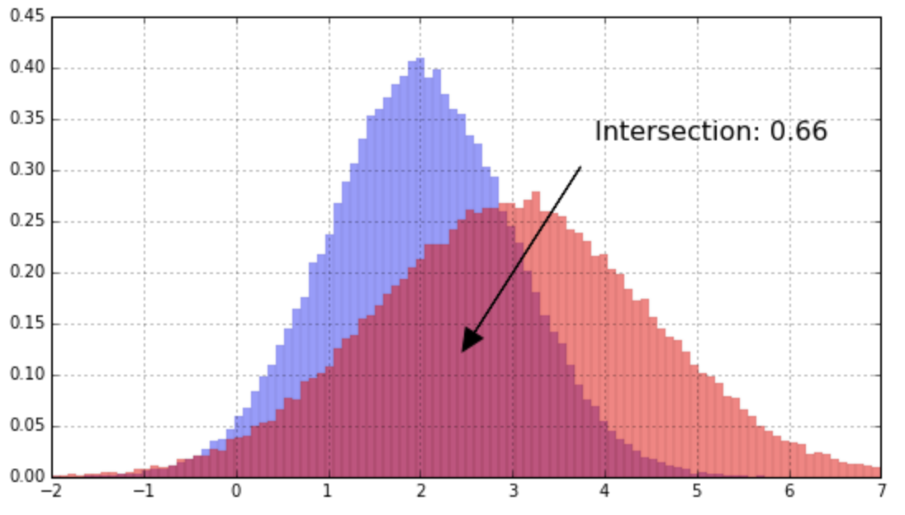
Selective Search: Color Similarity

Slide 14
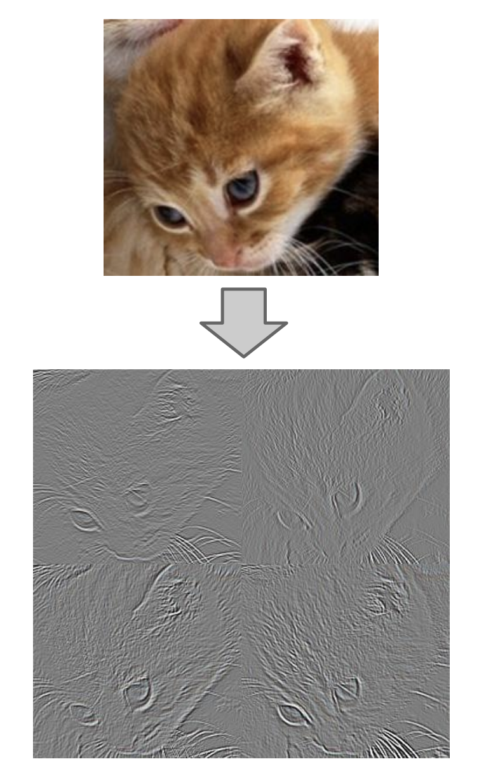
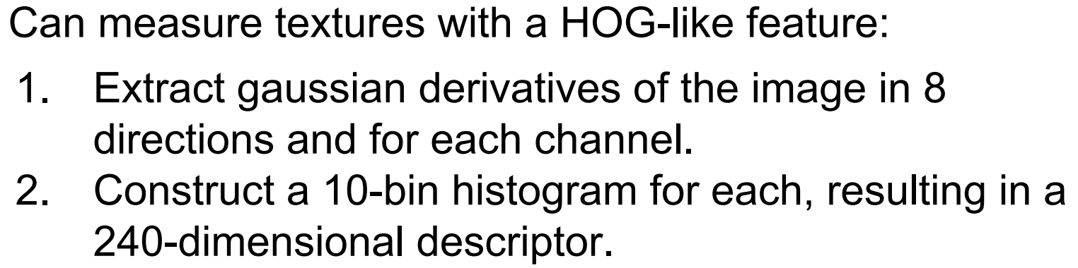
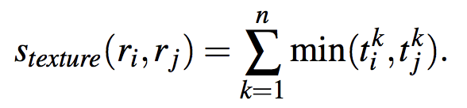
Selective Search: Texture Similarity

Slide 15
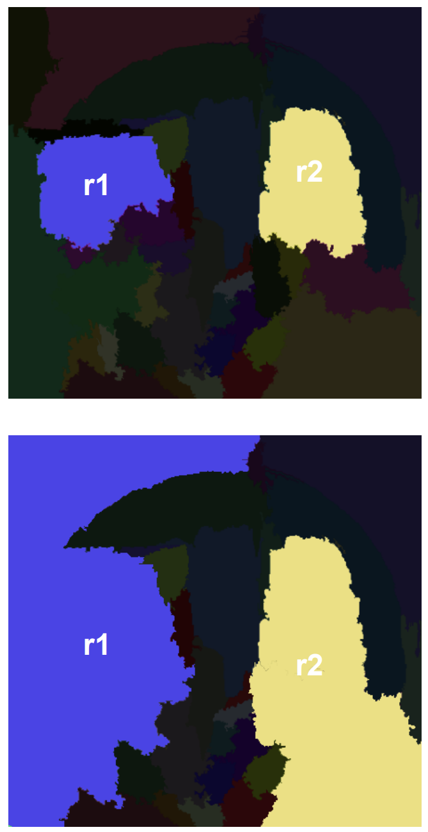
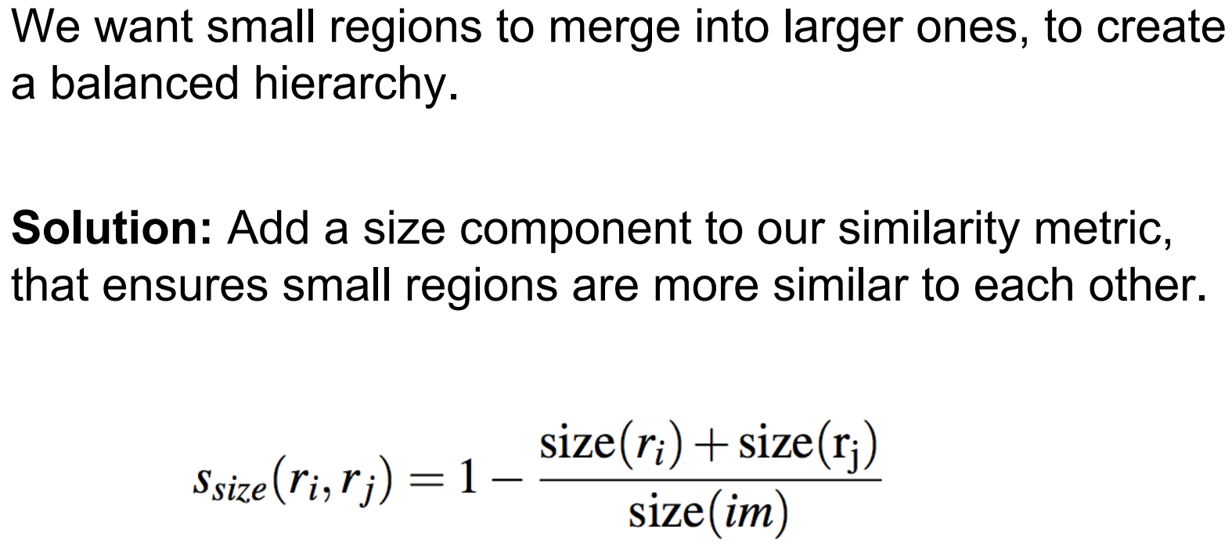
Selective Search: Size Similarity

Slide 16
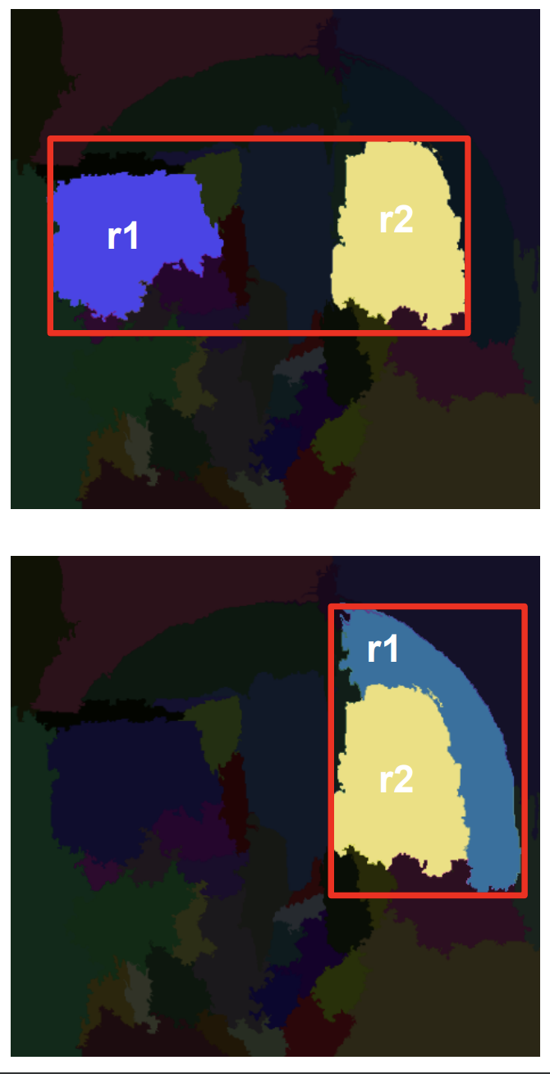
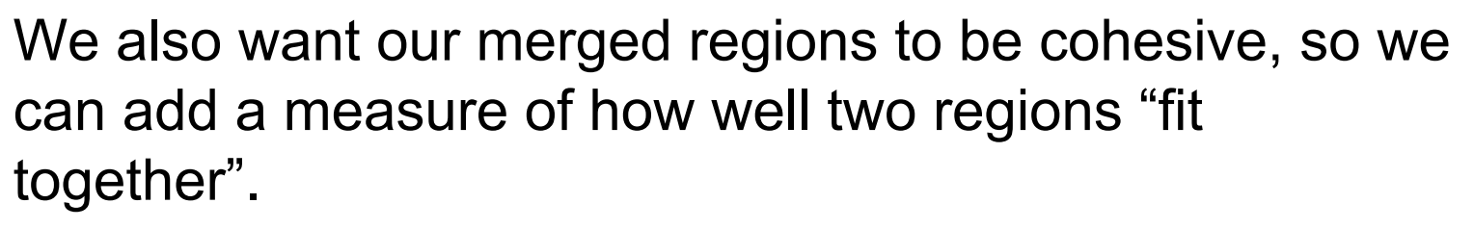
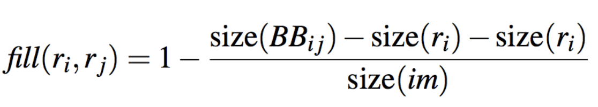
Selective Search: Shape Similarity

Slide 17
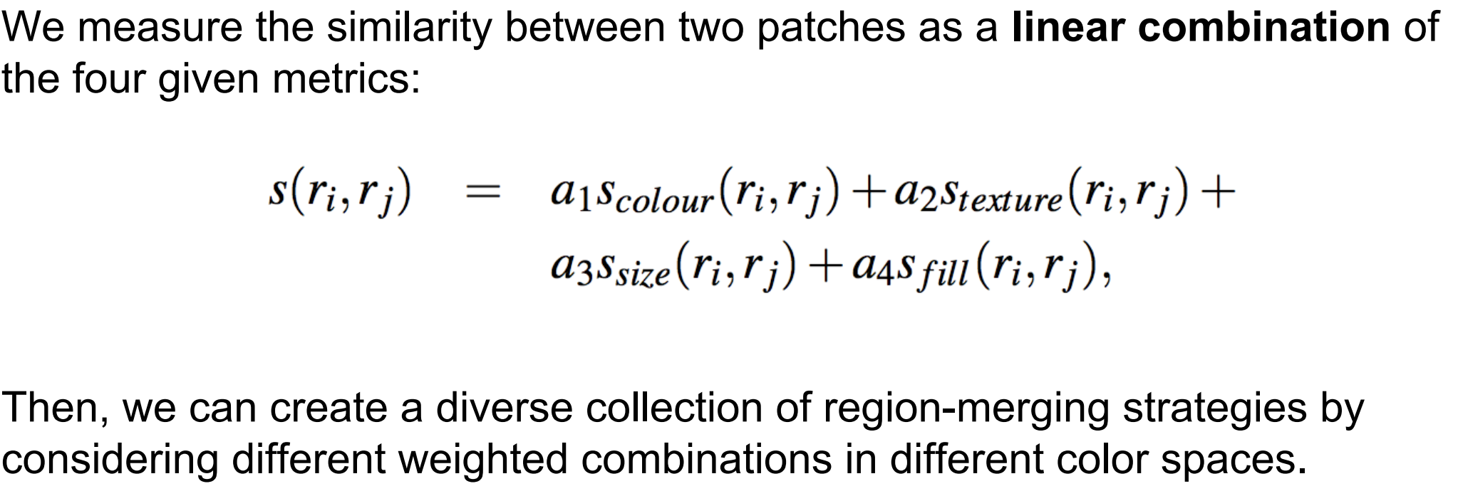
Selective Search: Similarity

Slide 18
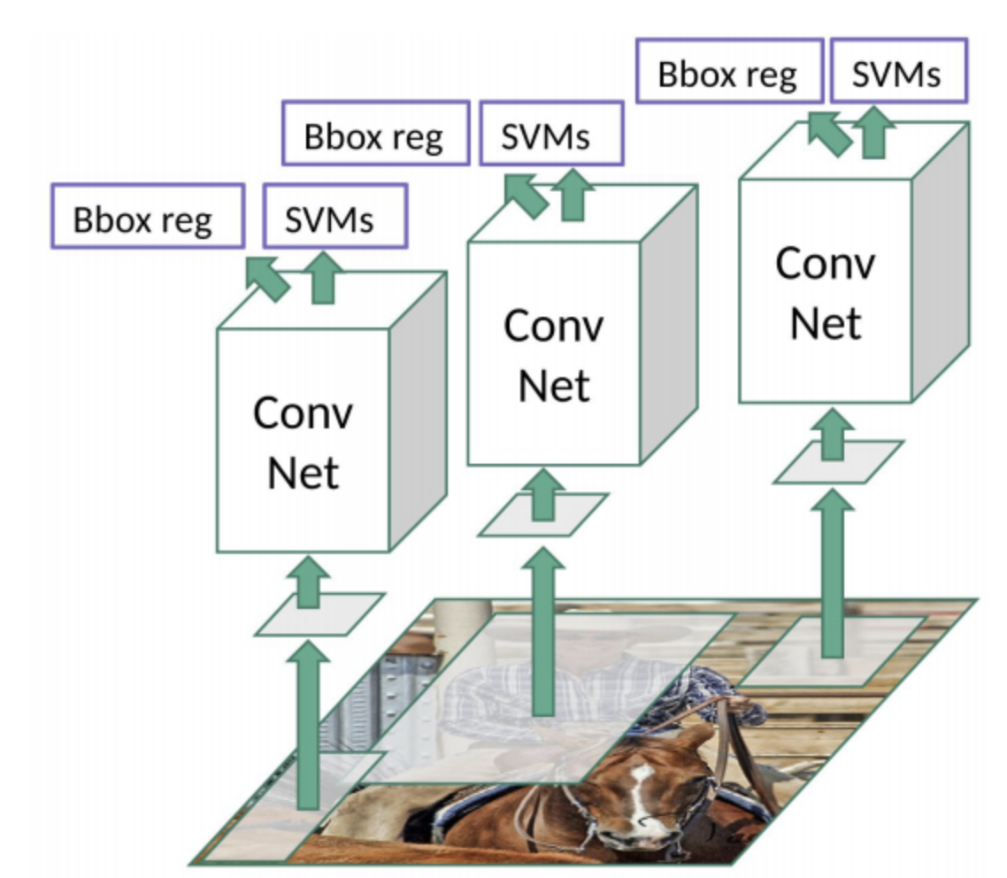
RCNN (2014)
Warping can be done using max pooling to downsample and bilinear interpolation to upsample.
Algorithm:
Use the selective search algorithm to generate regions of interest.
Warp each ROI into a fixed-size region to serve as input to the CNN.
Classify (SVMs) objects of interest and tighten bounding box (non-max suppression and regression) per ROI.

Slide 19
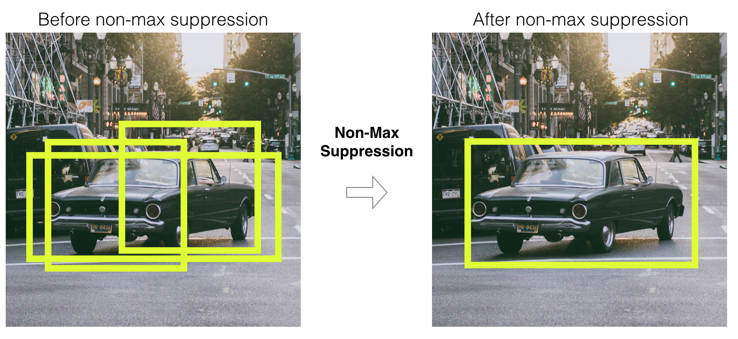
RCNN (2014)
Algorithm:
Use the selective search algorithm to generate regions of interest.
Warp ROIs into a fixed-size region to serve as input to the CNN.
Classify (SVMs) objects of interest and tighten bounding box (non-max suppression and regression) per ROI.
An SVM must be trained per object of interest. All ROIs (from multiple images) containing such object form a class and the remaining ROIs form the other class.

Slide 20
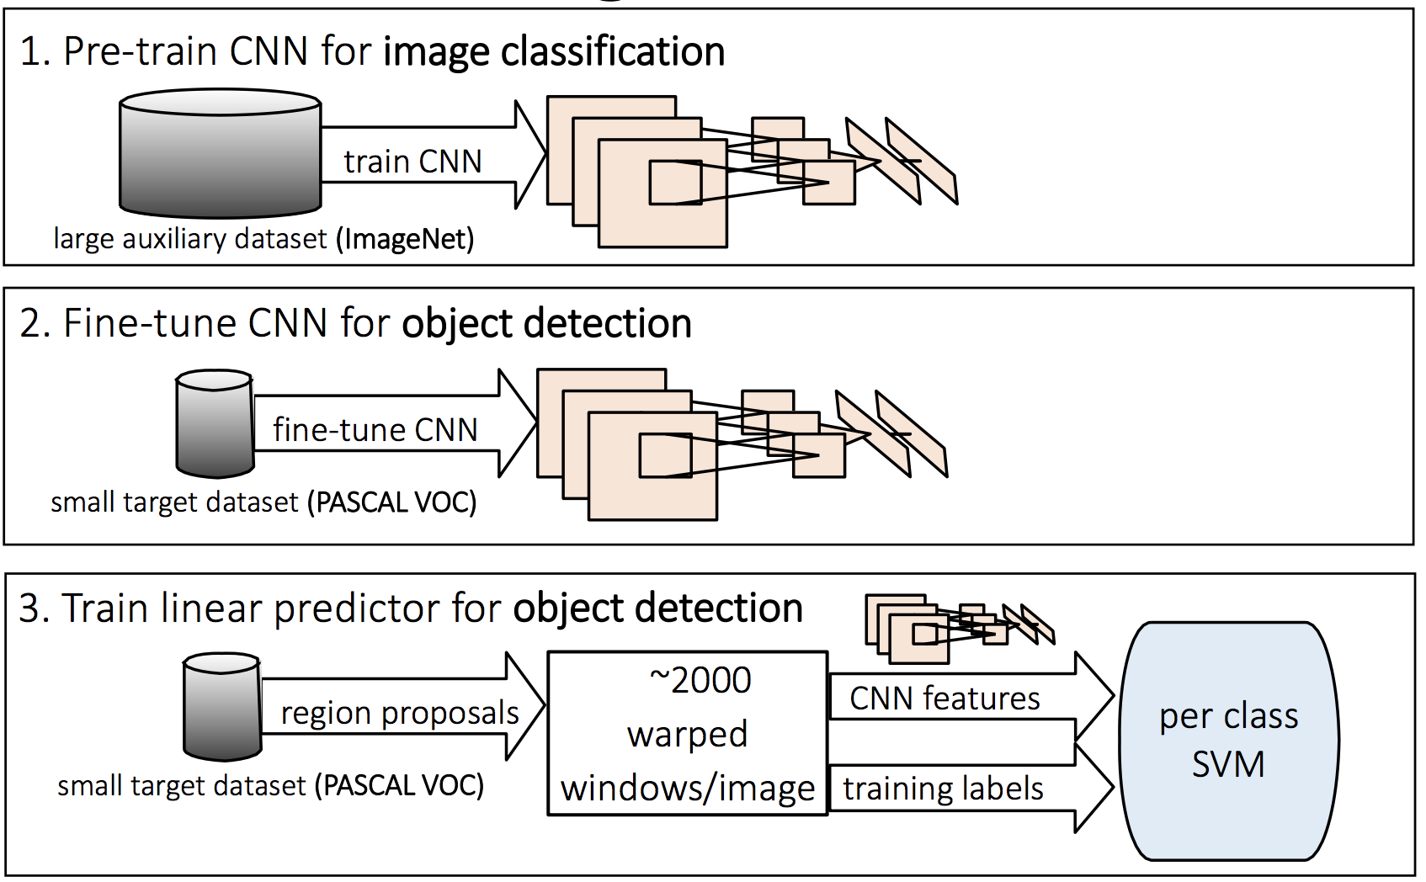
RCNN: Training

Slide 21
RCNN: Limitations
Slow training as you would have to classify 2000 ROIs per image.
There are three disconnected models: CNN feature extractor, bounding box regressor, and SVM classifier.
The CNN features for the 2000 ROIs for all the training images must be stored in memory to train the SVMs.
The model cannot infer in real time as it takes around 47 seconds for each test image.
The selective search algorithm is a fixed algorithm. Thus, no learning is happening at that stage.

Slide 22
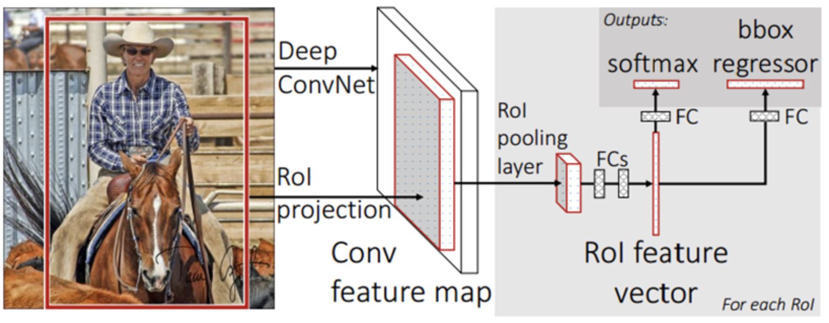
Fast RCNN (2015)
First passes the whole image through a CNN to derive a feature space.
Then it projects the ROIs obtained from selective search onto the feature space.
Unifies the three independent models into one jointly trained framework.
By increasing shared computation, this approach reduces computing power significantly.
A softmax classifier is equivalent to minimizing the categorical (multi-class) cross entropy loss.

Slide 23
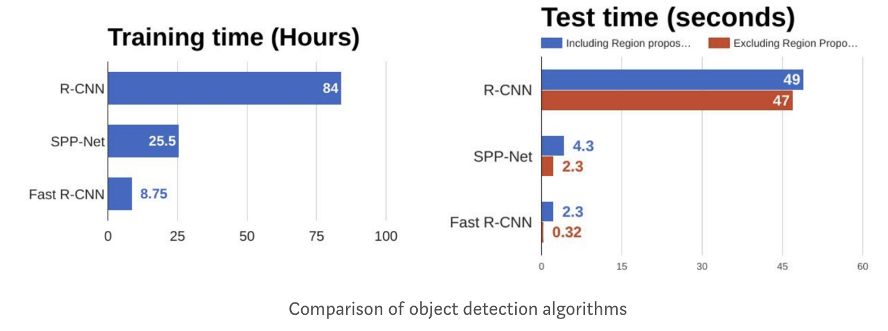
Fast RCNN: Comparison and Limitations
The generation of ROIs (selective search) is a computing bottleneck.
The selective search algorithm is a fixed algorithm. Thus, no learning is happening at that stage.

Slide 24
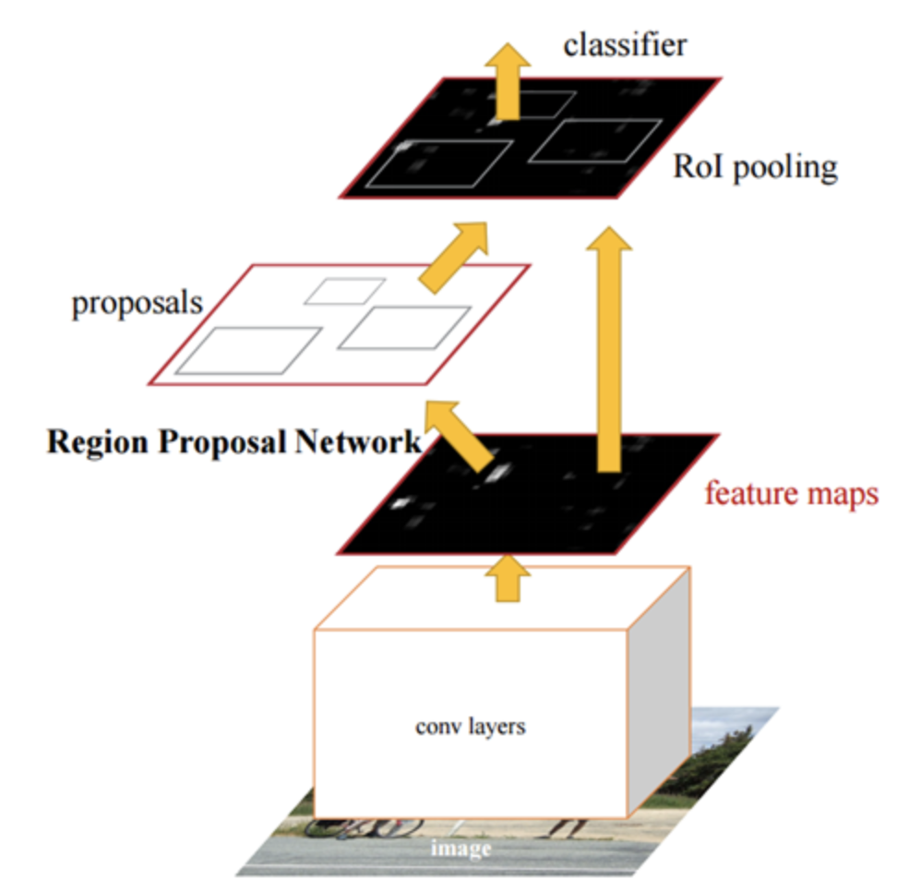
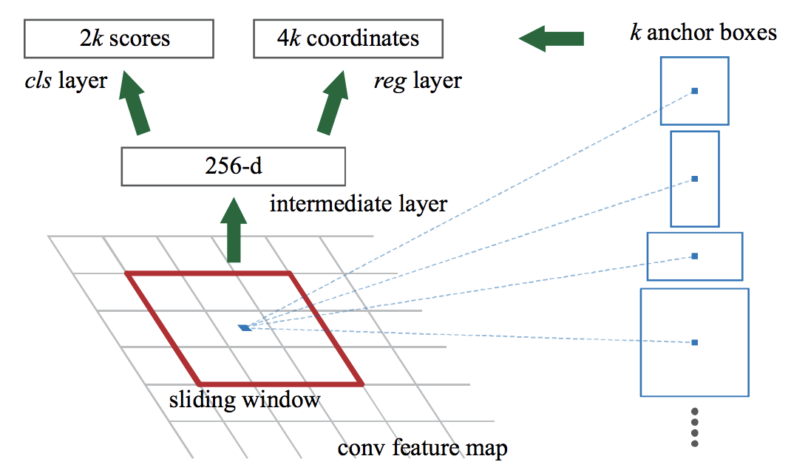
Faster RCNN (2016)
Uses a region proposal network (RPN, i.e., a CNN) to propose ROIs instead of using selective search.
The RPN uses features of the image that were already extracted from the first CNN.
The RPN uses anchor boxes parametrized by 3 scales and 3 aspect ratios, for a total of 9 ROIs per pixel.
The RPN classification loss deals with finding any object inside the ROI or not.

Slide 25
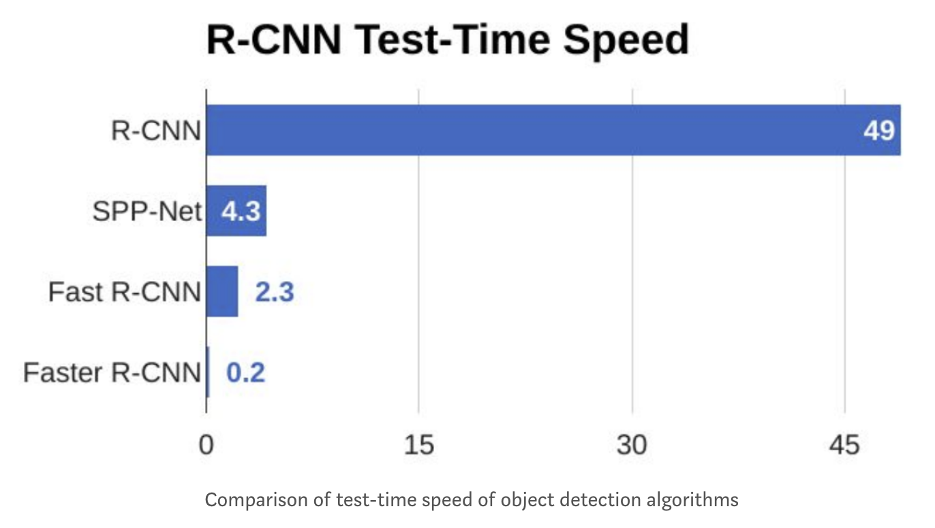
Faster RCNN: Comparison
From the graph below, we can see that Faster R-CNN is much faster than its predecessors. Thus, it can be used for real-time object detection.

Slide 26
Faster RCNN Implementation
Clone the following repository: https://github.com/kbardool/keras-frcnn
Repo is very well documented.
You will need to download the Pascal VOC dataset.
Thank you!

