Slide 1
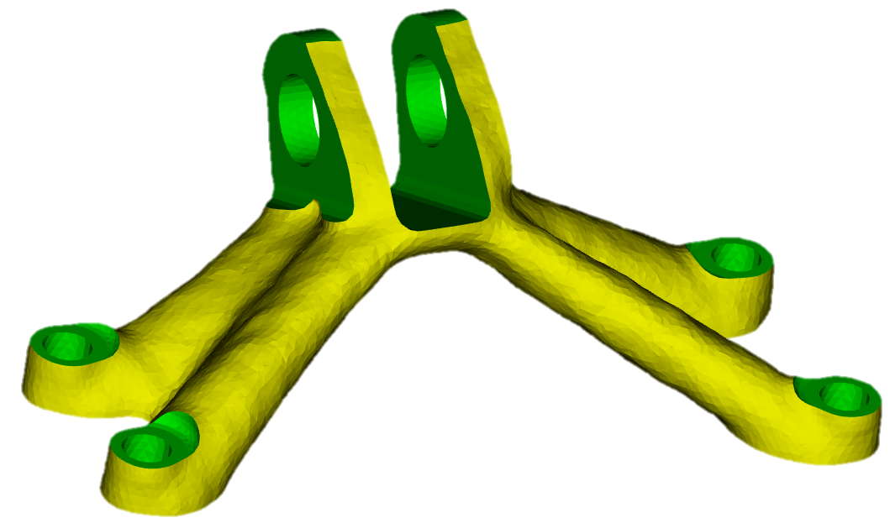
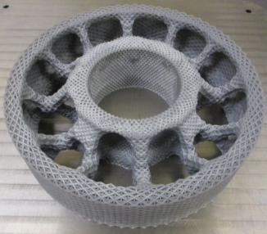
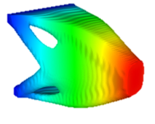
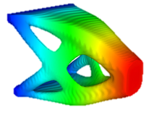
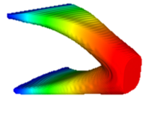
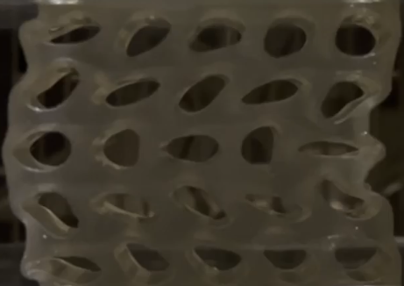
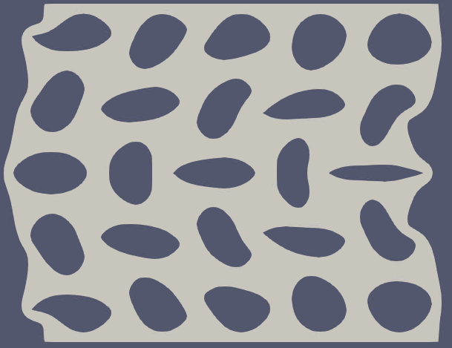
Plato optimization-based design
PDE-Constrained Shape and Topology Optimization
Sean Hardesty
Org. 1543, Simulation Modeling Sciences
East Cost Optimization Meeting
April 17, 2025
SAND2025-04659C

Slide 2



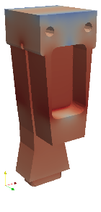
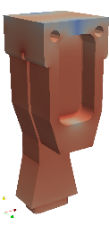
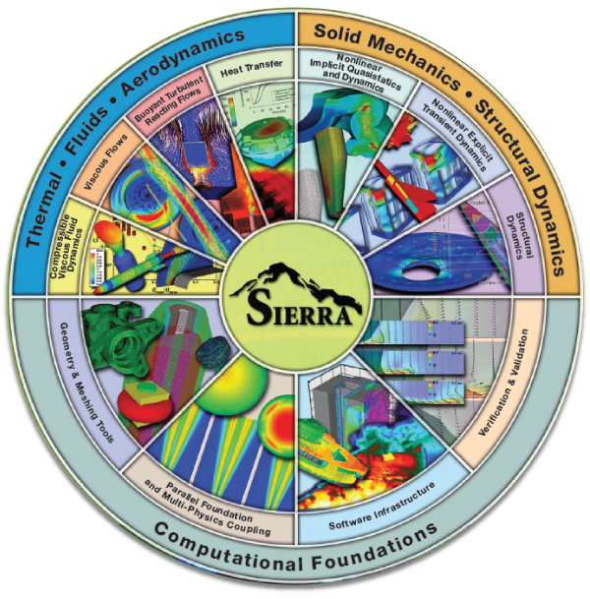
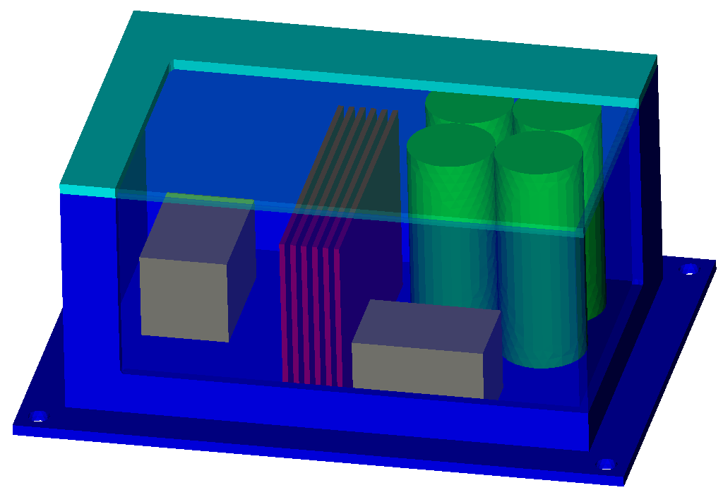
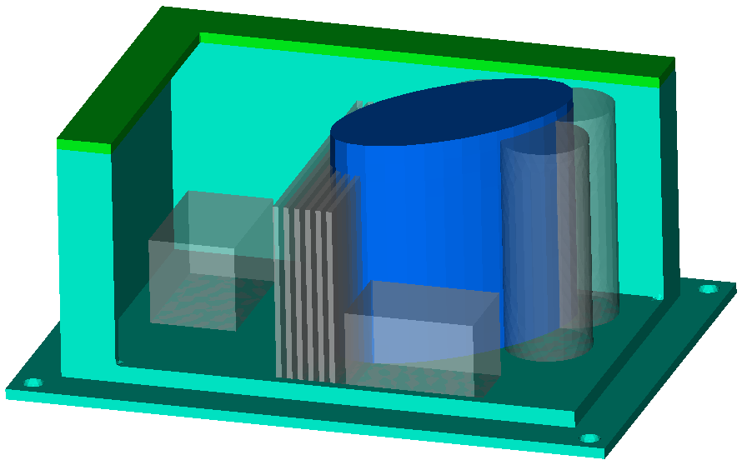
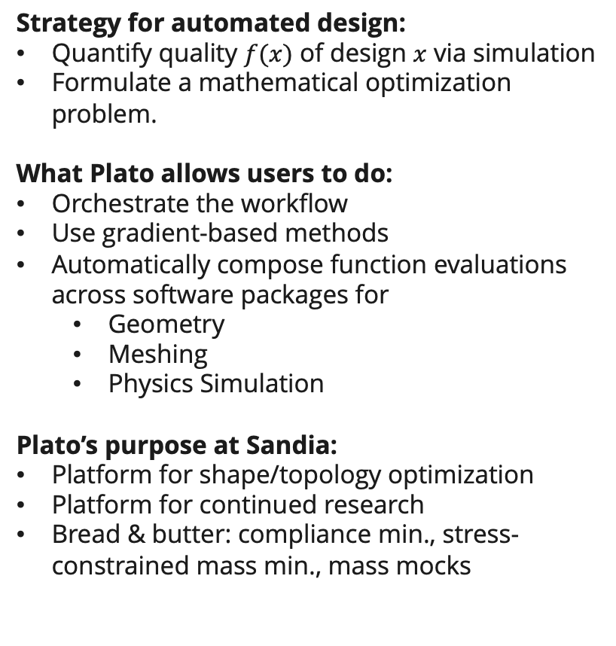



Plato: optimization-based geometry design
Gradient-Based Optimization
Strategy for automated design:
Quantify quality $f(x)$ of design $x$ via simulation
Formulate a mathematical optimization problem.
What Plato allows users to do:
Orchestrate the workflow
Use gradient-based methods
Automatically compose function evaluations across software packages for
  Geometry
  Meshing
  Physics Simulation
Plato’s purpose at Sandia:
Platform for shape/topology optimization
Platform for continued research
Bread & butter: compliance min., stress-constrained mass min., mass mocks
$$m\text{in} f(x)$$
$$\text{s}\text{.}\text{t}\text{. }c\left(x\right)≤0$$
$$x$$
$$f\left(x\right), ∇f(x)$$
$$c\left(x\right), ∇c(x)$$
Shape
Topology
Mesh
Sierra Mechanics

Slide 3



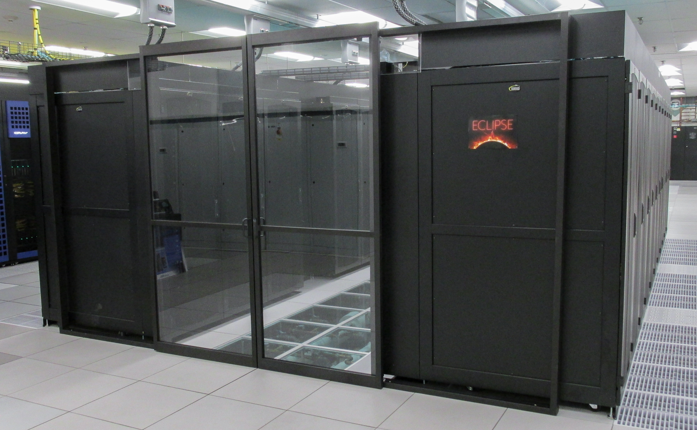





SIERRA Mechanics Overview
Focus evaluation on CTS-1
and ATS-2 platforms
Build, Test, Exec, Deliver
CTS-1
Application Interfaces
Solvers
Parallel Mesh Database
ATS-2
Kokkos
Kokkos
Third-party Libraries
Notes:
Development of high-performance computing; collaboration on hardware architecture.

Slide 4

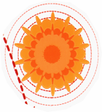
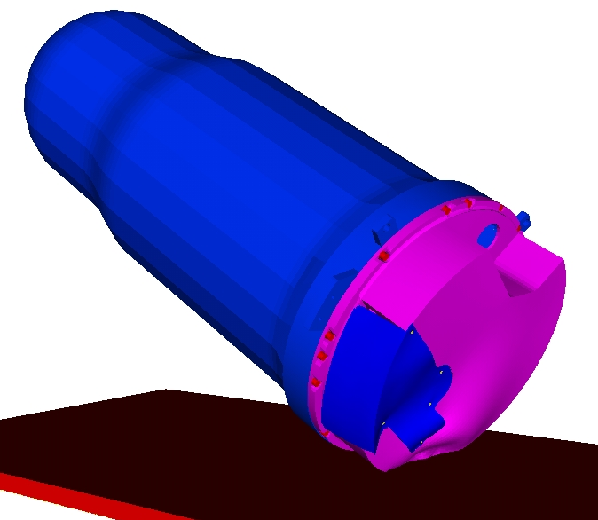

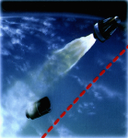


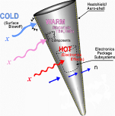
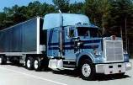
The Nuclear Weapons program is the principal driver for Sandia’s Computational Simulation efforts
Separation shock/ Aerodynamic Heating
Assured Safety and Security
Delivery
Mechanical Insult
Thermal Insult
Survivability
Electromagnetic Insult
Staging shock
Radiation Effects
Security Components
Random
vibration
Assured Performance & Manufacturing
Safe & Secure Transport
Notes:
Recommend ”Command and Control” by Eric Schlosser
Explain why we are interested in modal optimization: design, mocks, fixtures.

Slide 5
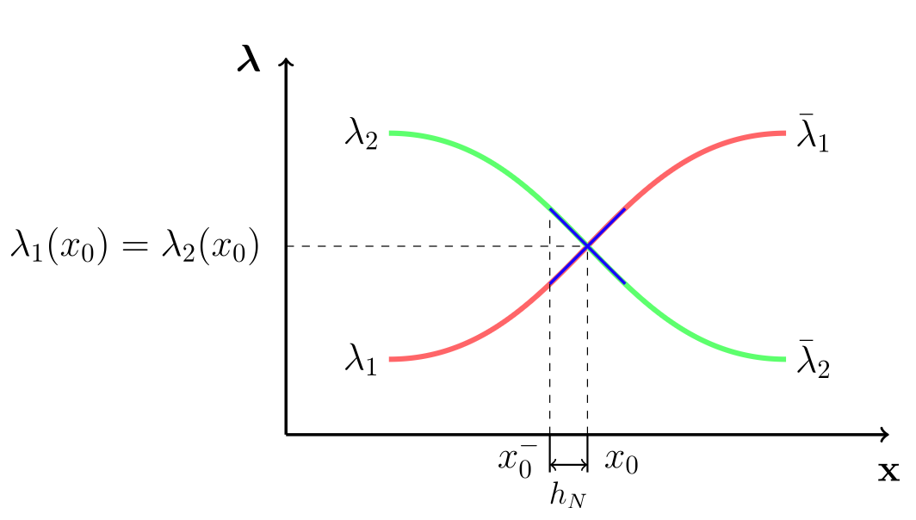
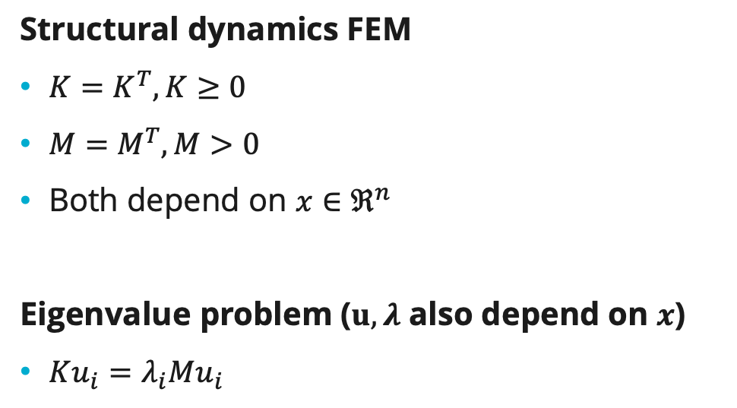
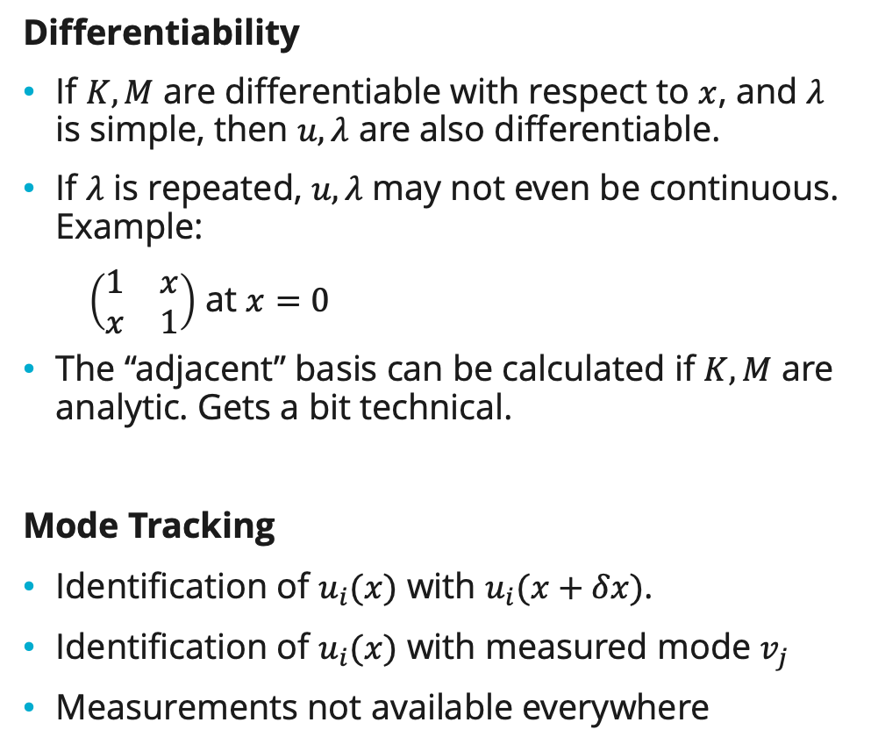
Modal Optimization
Structural dynamics FEM
$K=K^{T}, K≥0$
$M=M^{T}, M>0$
Both depend on $x∈ℜ^{n}$
Eigenvalue problem ($u,λ$ also depend on $x$)
$Ku_{i}=λ_{i}Mu_{i}$
Differentiability
If $K,M$ are differentiable with respect to $x$, and $λ$ is simple, then $u,λ$ are also differentiable.
If $λ$ is repeated, $u,λ$ may not even be continuous. Example:
  $\left(\begin{matrix}1 & x \\ x & 1\end{matrix}\right)$ at $x=0$
The “adjacent” basis can be calculated if $K,M$ are analytic. Gets a bit technical.
Mode Tracking
Identification of $u_{i}(x)$ with $u_{i}(x+δx)$.
Identification of $u_{i}(x)$ with measured mode $v_{j}$
Measurements not available everywhere
Figure from Ruiz et al., 2017
Notes:
Obviously problematic to work with raw ARPACK output sorting by eigenvaules.
This talk will focus on mode tracking.

Slide 6
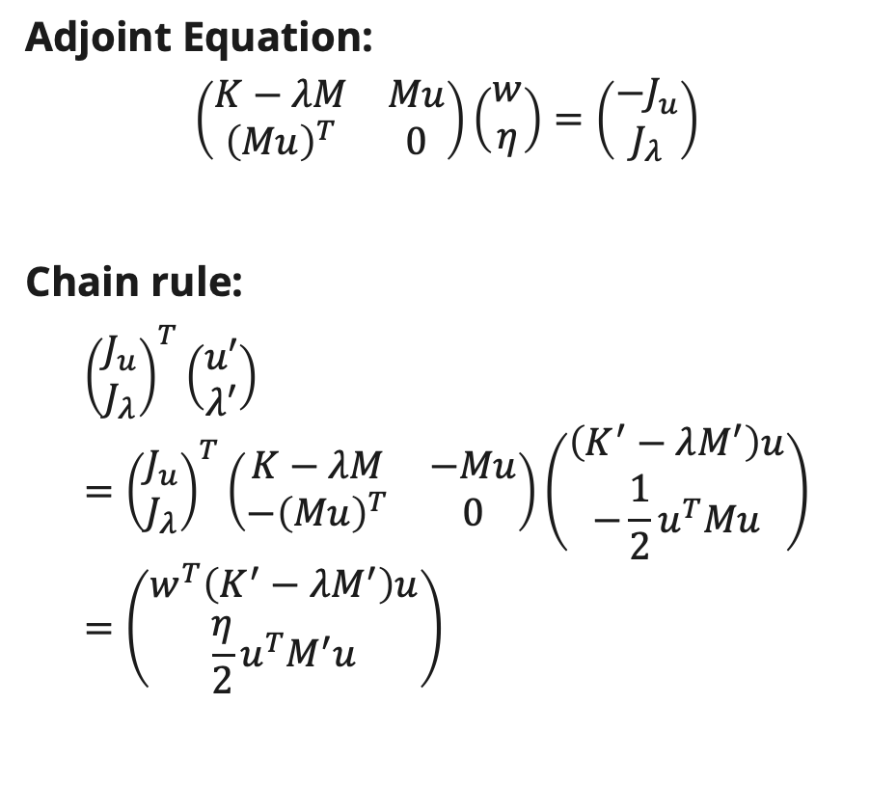
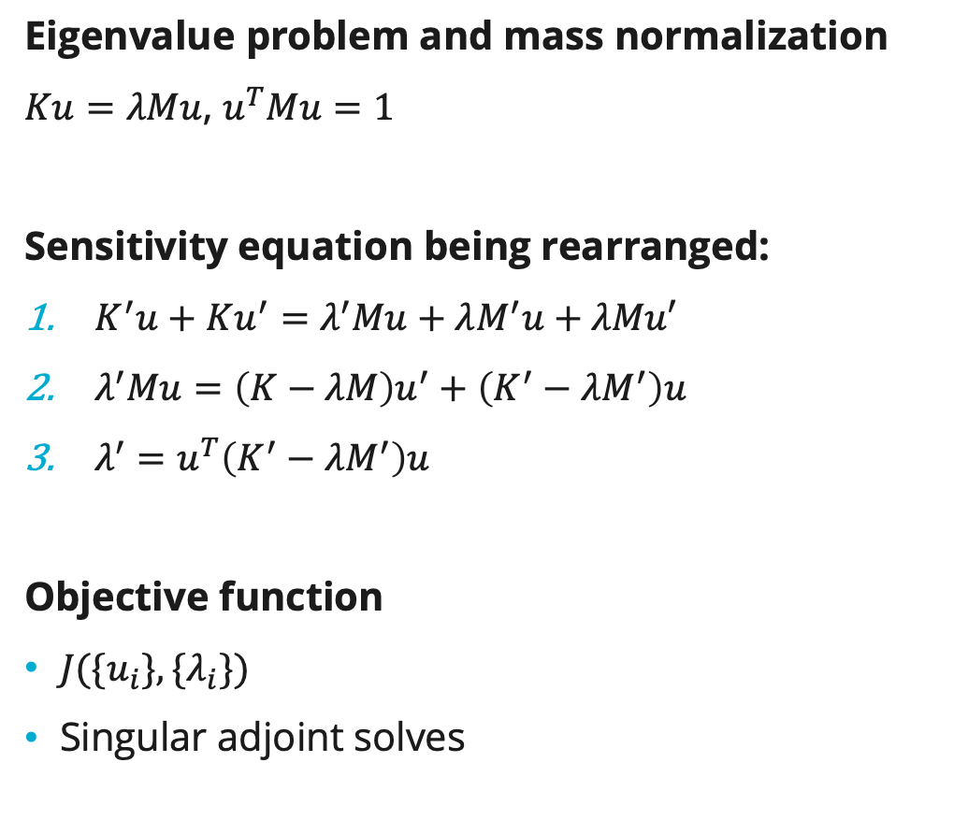
Adjoint formulation ($λ$ simple)
Eigenvalue problem and mass normalization
$Ku=λMu$, $u^{T}Mu=1$
Sensitivity equation being rearranged:
$K^{′}u+Ku^{′}=λ^{′}Mu+λM^{′}u+λMu′$
$λ^{′}Mu=\left(K−λM\right)u^{′}+\left(K^{′}−λM^{′}\right)u$
$λ^{′}=u^{T}\left(K^{′}−λM^{′}\right)u$
Objective function
$J(\{u_{i}\},\{λ_{i}\})$
Singular adjoint solves
Adjoint Equation:
$$\left(\begin{matrix}K−λM & Mu \\ {\left(Mu\right)}^{T} & 0\end{matrix}\right)\left(\begin{matrix}w \\ η\end{matrix}\right)=\left(\begin{matrix}−J_{u} \\ J_{λ}\end{matrix}\right)$$
Chain rule:
$${\left(\begin{matrix}J_{u} \\ J_{λ}\end{matrix}\right)}^{T}\left(\begin{matrix}u′ \\ λ′\end{matrix}\right)={\left(\begin{matrix}J_{u} \\ J_{λ}\end{matrix}\right)}^{T}\left(\begin{matrix}K−λM & −Mu \\ −{\left(Mu\right)}^{T} & 0\end{matrix}\right)\left(\begin{matrix}\left(K^{′}−λM^{′}\right)u \\ −\frac{1}{2}u^{T}Mu\end{matrix}\right)=\left(\begin{matrix}w^{T}\left(K^{′}−λM^{′}\right)u \\ \frac{η}{2}u^{T}M^{′}u\end{matrix}\right)$$
Notes:
Eigenvalue derivative, adjoint equation depend only on same eigenvalue, eigenvector!
Need for specialized linear solver formulation.

Slide 7
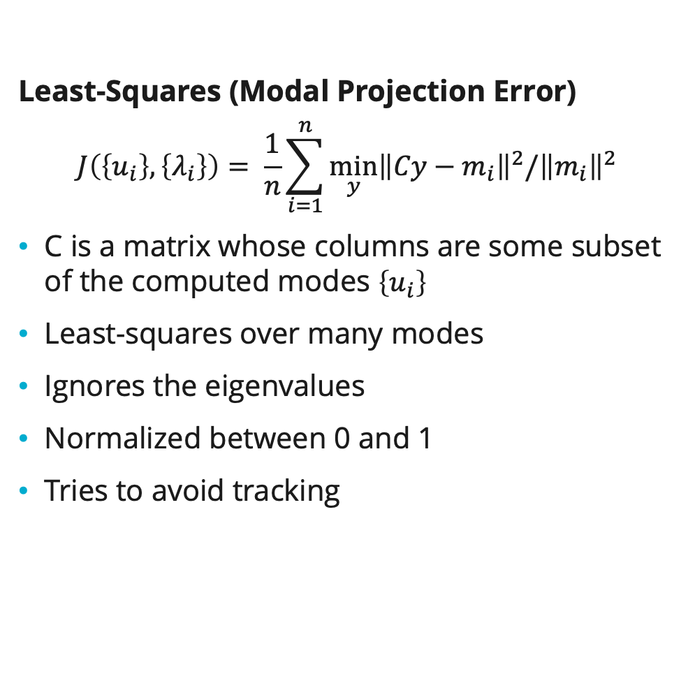
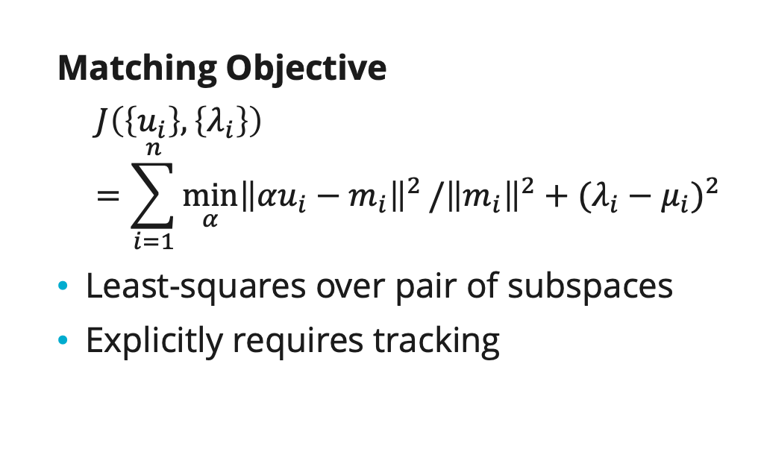




Modal Objectives
Least-Squares (Modal Projection Error)
$$J\left(\left\{u_{i}\right\},\left\{λ_{i}\right\}\right)= \frac{1}{n}\sum_{i=1}^{n}{\min_{y}{{\left\|Cy−m_{i}\right\|}^{2}/{\left\|m_{i}\right\|}^{2}}}$$
C is a matrix whose columns are some subset of the computed modes $\left\{u_{i}\right\}$
Least-squares over many modes
Ignores the eigenvalues
Normalized between 0 and 1
Tries to avoid tracking
Matching Objective
$$J\left(\left\{u_{i}\right\},\left\{λ_{i}\right\}\right)=\sum_{i=1}^{n}{\min_{α}{{\left\|{αu}_{i}−m_{i}\right\|}^{2}}/{\left\|m_{i}\right\|}^{2}+{(λ_{i}−μ_{i})}^{2}}$$
Least-squares over pair of subspaces
Explicitly requires tracking
$$m_{2}$$
$$u_{1}$$
$$m_{1}$$
$$u_{2}$$
Eigenvector scaling as a least-squares problem
Notes:
Obviously problematic to

Slide 8
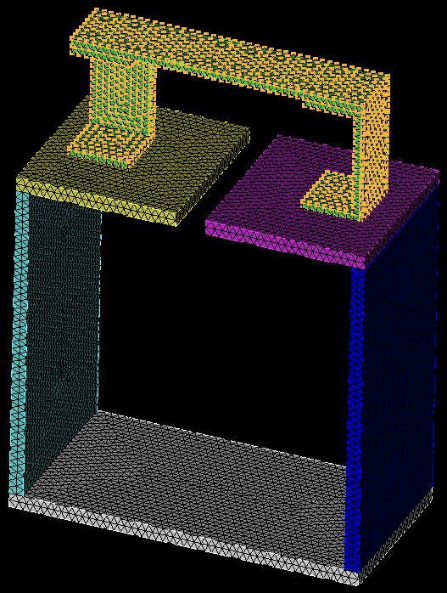
BARC Problem
Component that experiences dynamic environment (modal measurement points highlighted)
Next level assembly
Goal: Design a base to replace the next level assembly that will cause the component to experience the same dynamic environment it would see if attached to the original next level assembly.
Solution Approach: Use optimization to generate a base that has the same modal characteristics as the original next level assembly. We will be using the MPE modal objective in the optimization.
Notes:
Sean

Slide 9
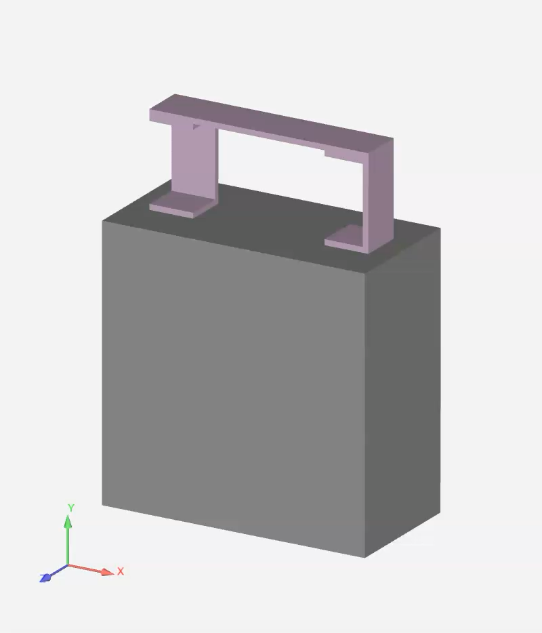
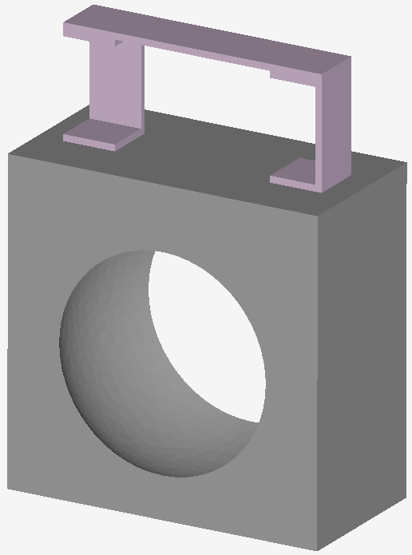
An Example Run…
Starting geometry
In this example we are trying to match the first elastic mode of the next level assembly with the first 19 elastic modes of the current iteration.
The main behavior we are looking at here is whether it will try to introduce a ”cut” between the feet of the component.
Notes:
Sean

Slide 10
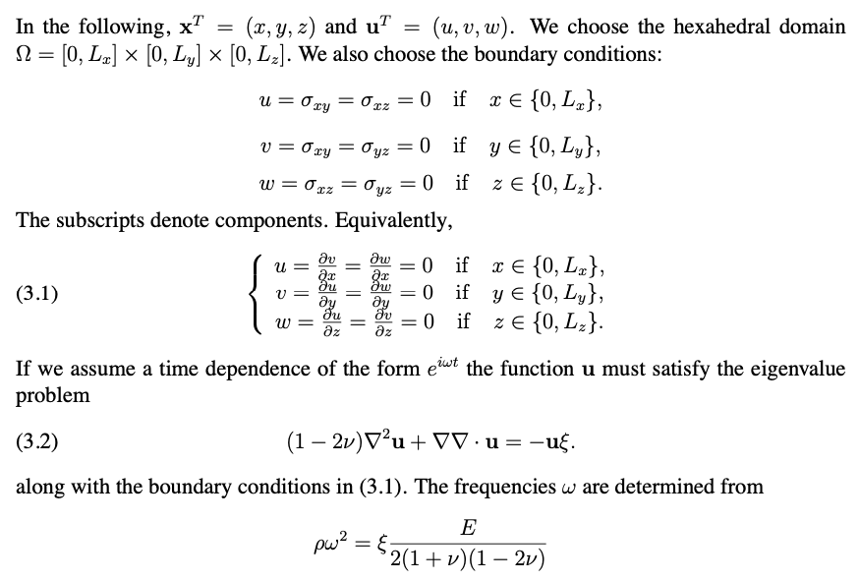
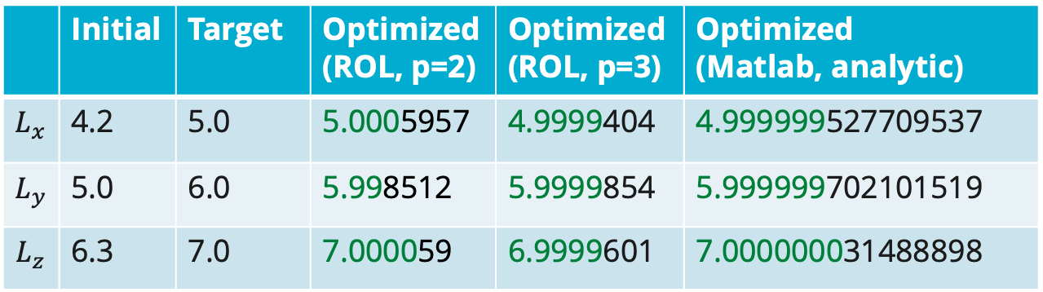
Model Problem
Why do we need an analytic solution?
Modal shape/topology optimization combines many working parts:
Re-meshing as design variables change
CAD or level-set mesh sensitivities
Finite Element approximation of the modes
Computation of the objective and gradient
From Day and Romero, 2004.
 | Initial | Target | Optimized (ROL, p=2) | Optimized (ROL, p=3) | Optimized (Matlab, analytic)
$$L_{x}$$ | 4.2 | 5.0 | 5.0005957 | 4.9999404 | 4.999999527709537
$$L_{y}$$ | 5.0 | 6.0 | 5.998512 | 5.9999854 | 5.999999702101519
$$L_{z}$$ | 6.3 | 7.0 | 7.000059 | 6.9999601 | 7.000000031488898
Notes:
Not all starting points converge.

Slide 11
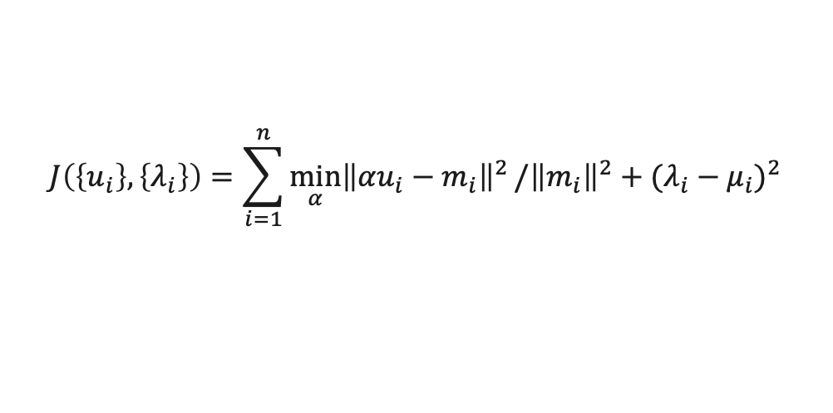
Matching objective (no tracking)
$$J\left(\left\{u_{i}\right\},\left\{λ_{i}\right\}\right)=\sum_{i=1}^{n}{\min_{α}{{\left\|{αu}_{i}−m_{i}\right\|}^{2}}/{\left\|m_{i}\right\|}^{2}+{(λ_{i}−μ_{i})}^{2}}$$

Slide 12
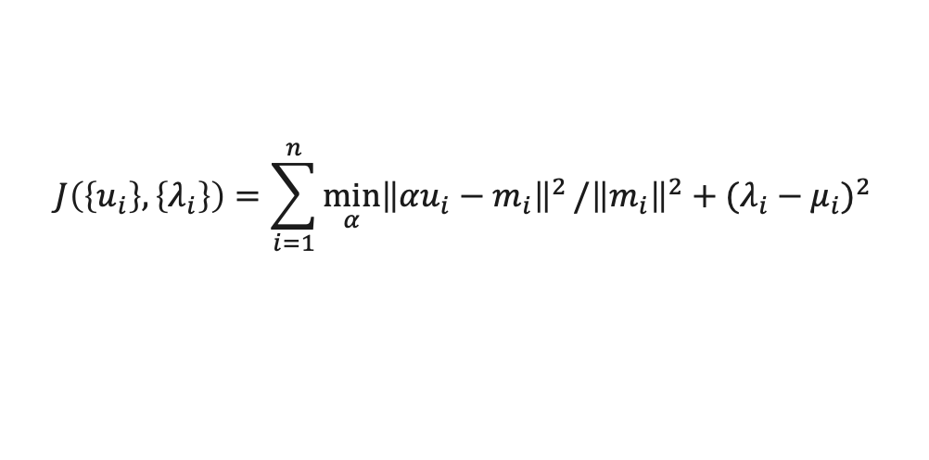
Matching objective (greedy tracking)
$$J\left(\left\{u_{i}\right\},\left\{λ_{i}\right\}\right)=\sum_{i=1}^{n}{\min_{α}{{\left\|{αu}_{i}−m_{i}\right\|}^{2}}/{\left\|m_{i}\right\|}^{2}+{(λ_{i}−μ_{i})}^{2}}$$
Notes:
“Hungarian” algorithm tracking result doesn’t look very different.

Slide 13
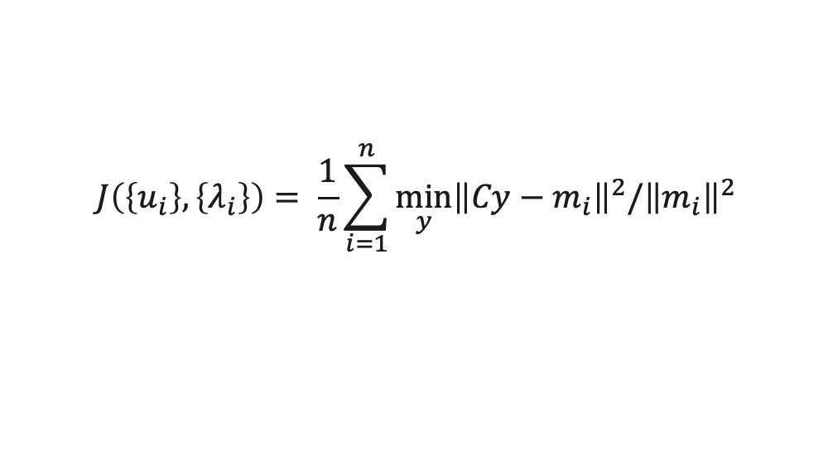
Least-squares (no tracking)
$$J\left(\left\{u_{i}\right\},\left\{λ_{i}\right\}\right)= \frac{1}{n}\sum_{i=1}^{n}{\min_{y}{{\left\|Cy−m_{i}\right\|}^{2}/{\left\|m_{i}\right\|}^{2}}}$$

Slide 14
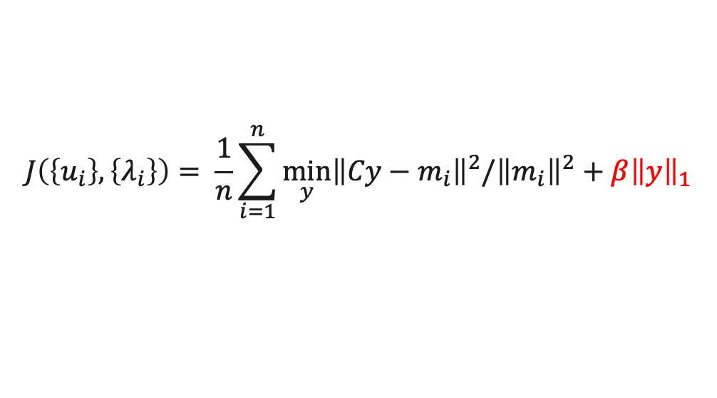
Least-squares (L1 regularization)
$$J\left(\left\{u_{i}\right\},\left\{λ_{i}\right\}\right)= \frac{1}{n}\sum_{i=1}^{n}{\min_{y}{{\left\|Cy−m_{i}\right\|}^{2}/{\left\|m_{i}\right\|}^{2}}}+β{\left\|y\right\|}_{1}$$

Slide 15
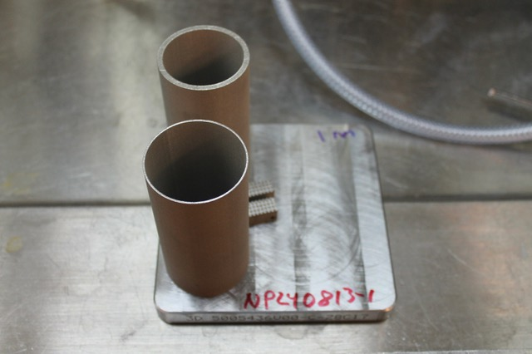
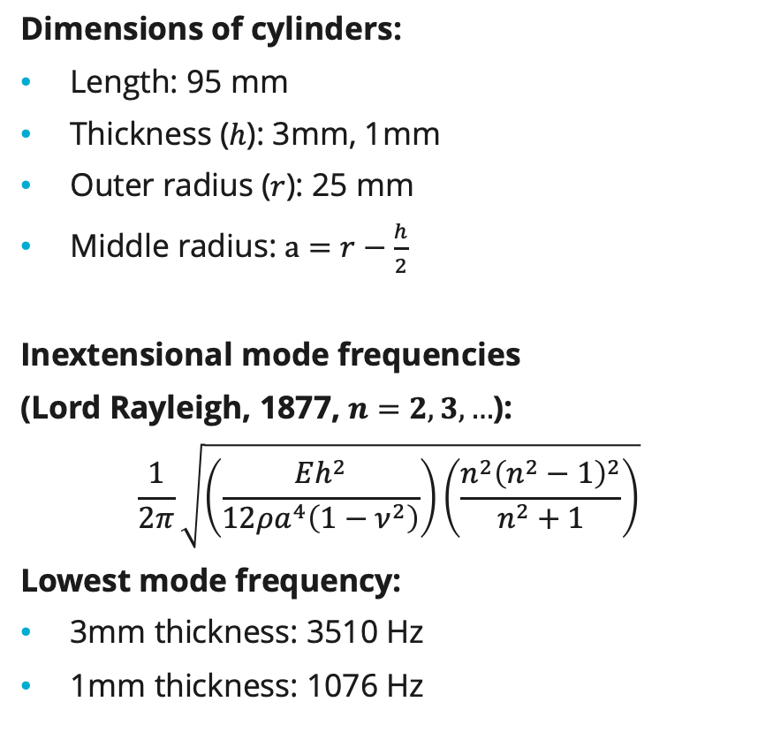
Frequency optimization of cylinders
Dimensions of cylinders:
Length: 95 mm
Thickness ($h$): 3mm, 1mm
Outer radius ($r$): 25 mm
Middle radius: $a=r−\frac{h}{2}$
Inextensional mode frequencies
(Lord Rayleigh, 1877, $n=2,3,…$):
$$\frac{1}{2π}\sqrt{\left(\frac{Eh^{2}}{12ρa^{4}\left(1−ν^{2}\right)}\right)\left(\frac{n^{2}{\left(n^{2}−1\right)}^{2}}{n^{2}+1}\right)}$$
Lowest mode frequency:
3mm thickness: 3510 Hz
1mm thickness: 1076 Hz

Slide 16
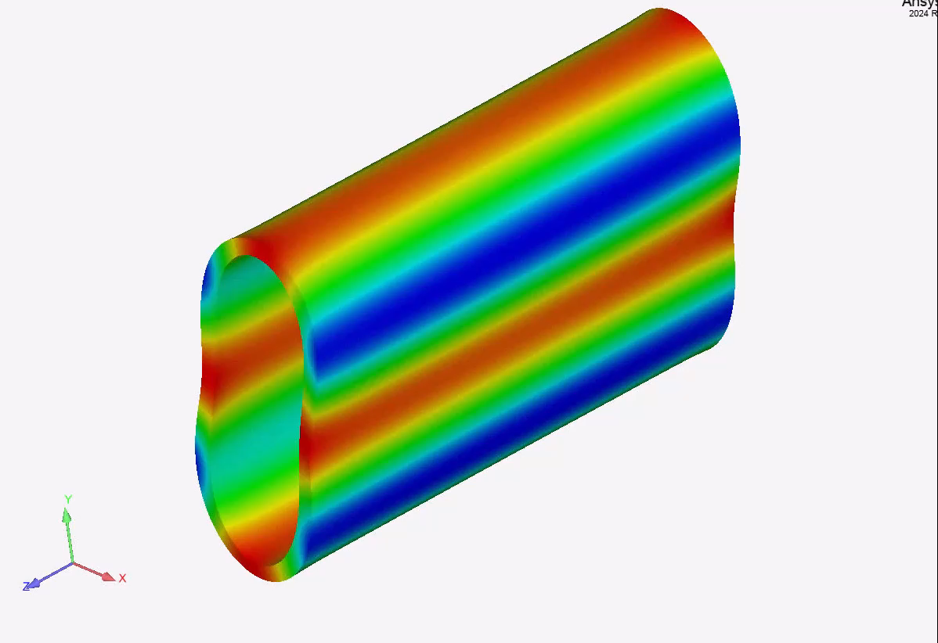
Known properties of thin cylinders
Stainless Steel
100mm long, 25mm outer radius, 3mm thickness
3,460 Hz (SD, Tet10)
3,510 Hz (Lord Rayleigh)
Goal: Raise the first natural frequency while maintaining the same mass.
Notes:
Sean

Slide 17
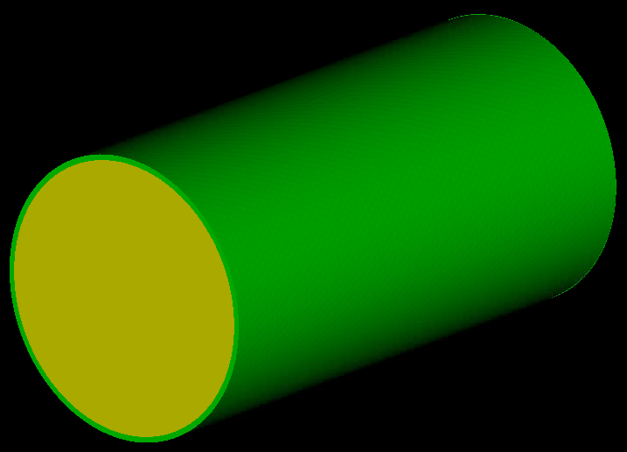
Plato Problem Setup
1mm thick fixed outer shell
Optimizable region
Objective:
Raise natural frequency (Sierra/SD)
Match mass target
Geometry Description: Levelsets via Krino
Notes:
Sean

Slide 18
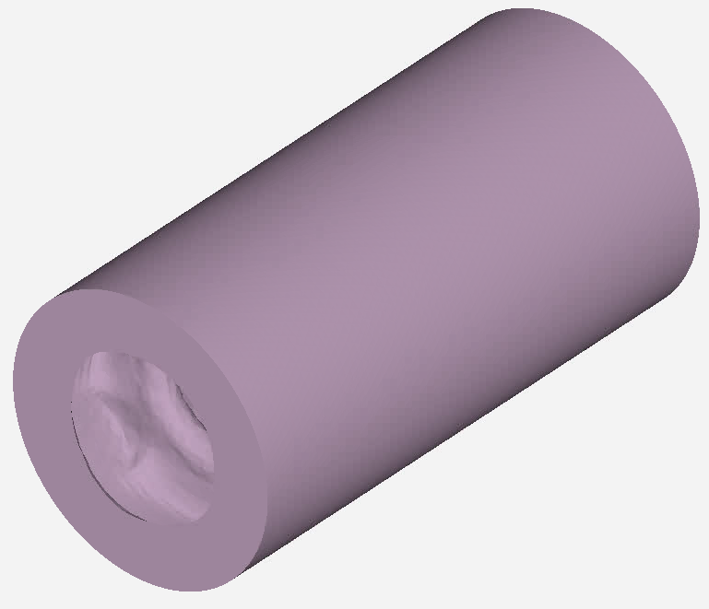
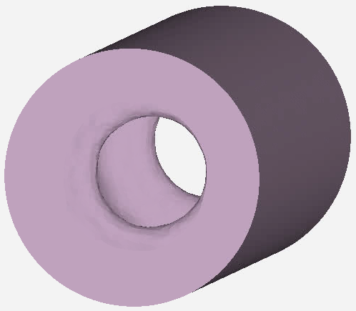
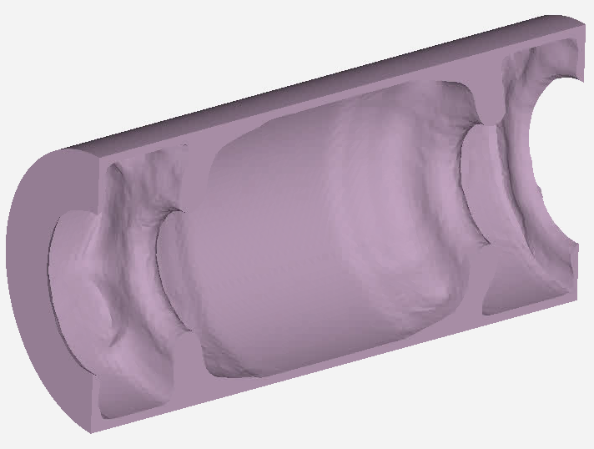
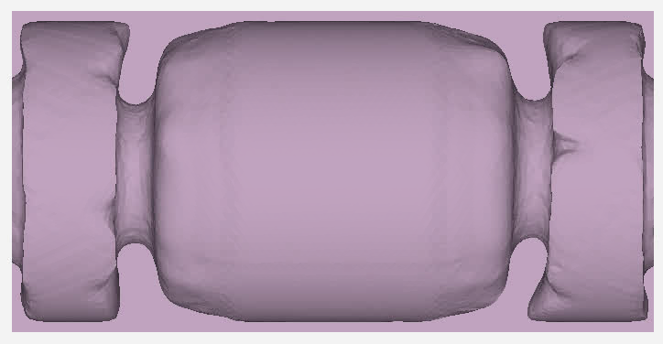
Optimized Design
Notes:
Sean

Slide 19
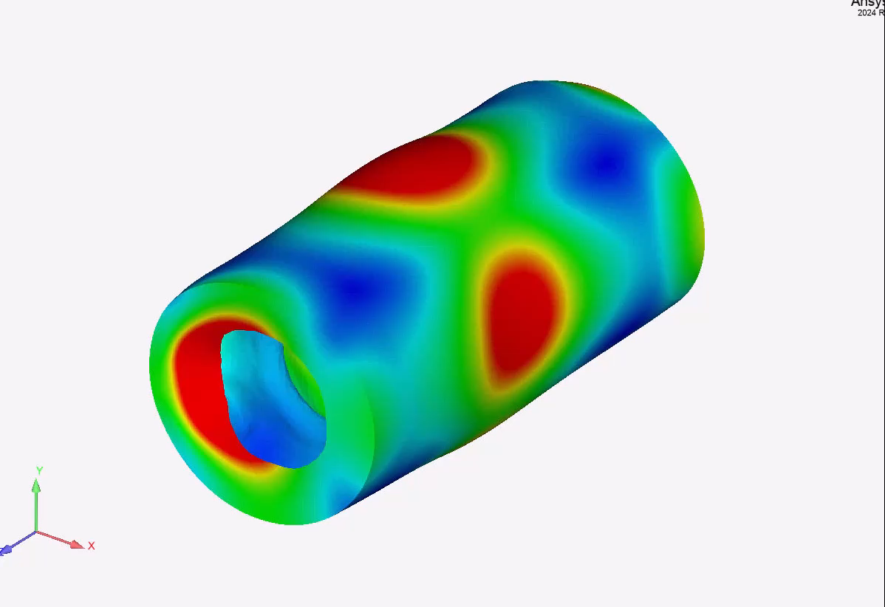
First Mode of Optimized Design
Frequency: 11,595 Hz
(235% increase from 3460 Hz)
Notes:
Sean

Slide 20
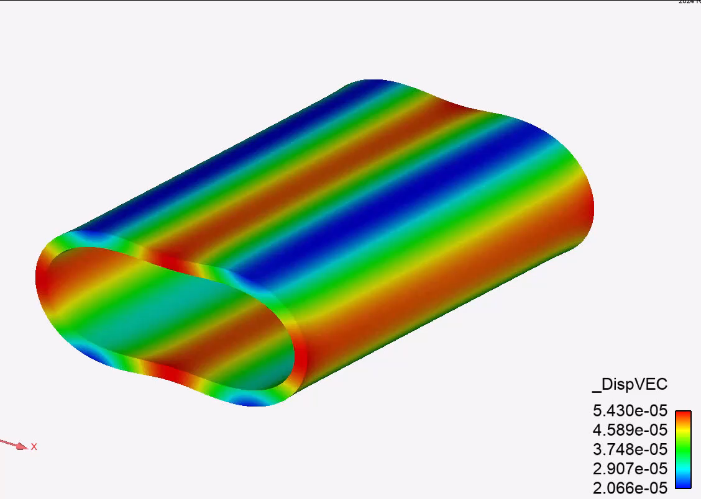
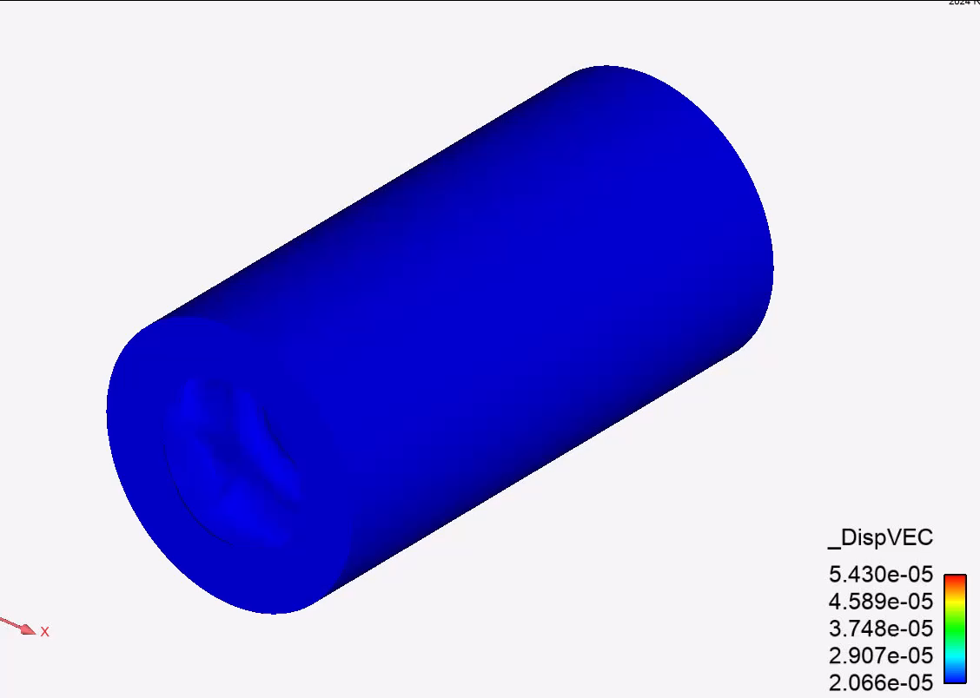
Performance at Frequency of Concern
Original frequency of concern: 3460 Hz
How will both the original design and the optimized design perform with a loading that would accentuate the first mode shape of the non-optimized design at the original frequency of concern?
A loading was derived based on the analytic calculation of the first mode shape of the cylinder and then applied at the 3300 Hz frequency (not right at the eigenvalue of 3460 Hz).
Unoptimized
@ 3300 Hz:
Max displacement unoptimized: 5.43e-5
Max displacement optimized: 9.075e-7
Optimized
Notes:
Sean

Slide 21

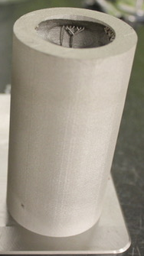
Comparison with computed values
3510 Hz (A7, Rayleigh)
3136 Hz (G7, Measured)
11595 Hz (F#9, SD)
11113 Hz (F9, Measured)
1076 Hz (C#6, Rayleigh)
927 Hz (A#5, Measured)
End of standard 88-key piano keyboard
https://www.google.com/url?sa=i&url=https%3A%2F%2Feducation.ti.com%2Fen%2F~%2Fmedia%2F41d1300939f1430a9ebb85e99d4de212.ashx%3Fh%3D16%26thn%3D1%26w%3D16%26rev%3Dce6b43e9-9ddb-48d0-8f0f-5d527196591e&psig=AOvVaw2Wbast8kM8WGBNeD9yZCnv&ust=1725036709629000&source=images&cd=vfe&opi=89978449&ved=0CBYQ3YkBahcKEwjYgefg1JqIAxUAAAAAHQAAAAAQBA

